Slide 1
World War I
“The Great War”
“The War to End All Wars”

Slide 2
Discussion Question
How does a war start? What determines how long a war will go on?

Slide 3
Platt Amendment
What did the provisions to the Platt Amendment say?

Slide 4
The First World War
What?
War involving over 60 of the world’s nations
When?
1914-1918 (U.S. enters in 1917)

Slide 5
Background of Europe
Germany forms the German empire
Germany steals some of France – starting problems between the two countries
France and Russia join a pact against Germany

Slide 6
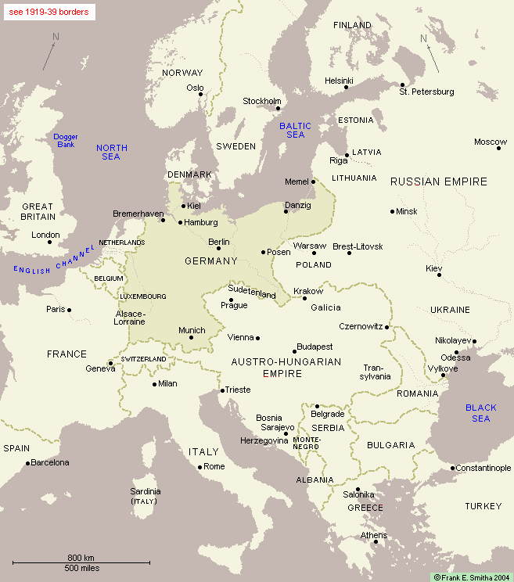

Slide 7
Causes of World War I
M – Militarism
A – Alliances
I – Imperialism
N - Nationalism

Slide 8
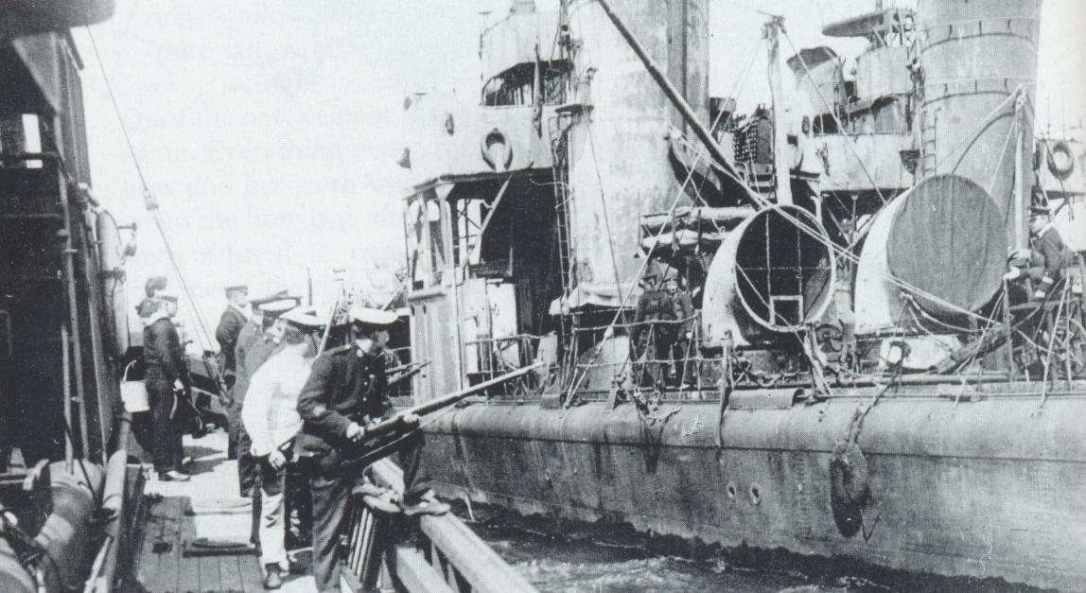
Militarism
A policy of aggressive military preparedness

Slide 9
Alliances
Countries entered into alliances to protect themselves in case of an attack

Slide 10
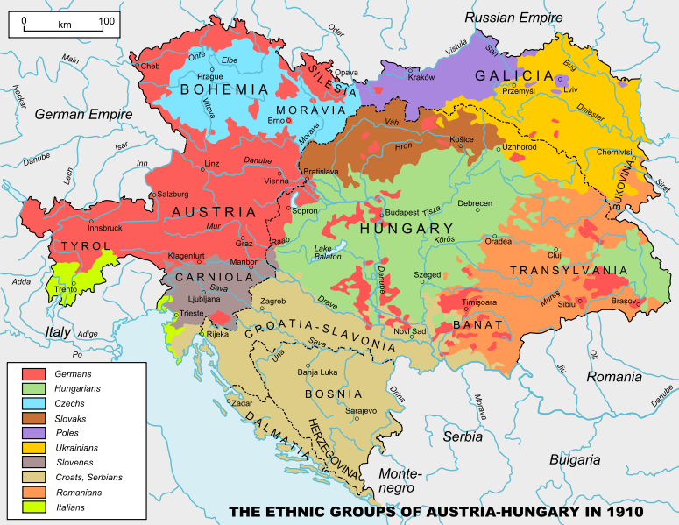
Imperialism
Economic and political domination of stronger countries over smaller/weaker countries

Slide 11
Nationalism
Loyalty and devotion to your country – willing to fight for it

Slide 12
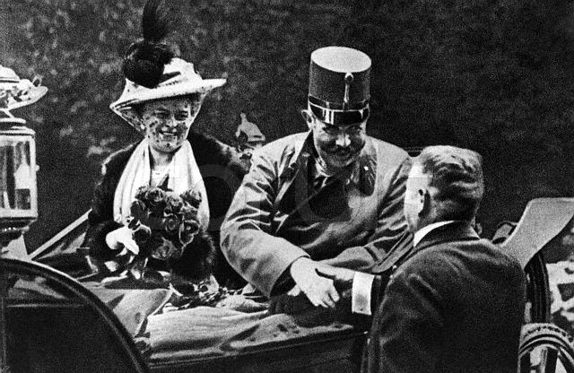
The Terrorist Attack
Franz Ferdinand – Archduke of Austro-Hungarian Empire
Gavrilo Princip – A Serbian nationalist – wanted to start a war to bring down the Austro-Hungarian Empire
Franz Ferdinand, Archduke of Austria and his wife, Sophie, Duchess of Hohenberg one hour before their deaths, June 28, 1914

Slide 13
Alliances are Triggered
Who had already formed alliances?

Slide 14
The Two Sides
Who?
Central Powers:
Allies:
Germany
Austria-Hungary
Ottoman Empire
Bulgaria
Russia
France
Great Britain
Italy
Japan

Slide 15
The United States enters WWI
Which side should the U.S. pick?

Slide 16
Which side should the U.S. pick?
Central Powers:
Allies:
11 million German-Americans
Irish-Americans hated Great Britain
Close cultural ties
Shared transatlantic cables (so censored stories)
Big business loaned much $ to allies
US Exports to both sides:

Slide 17
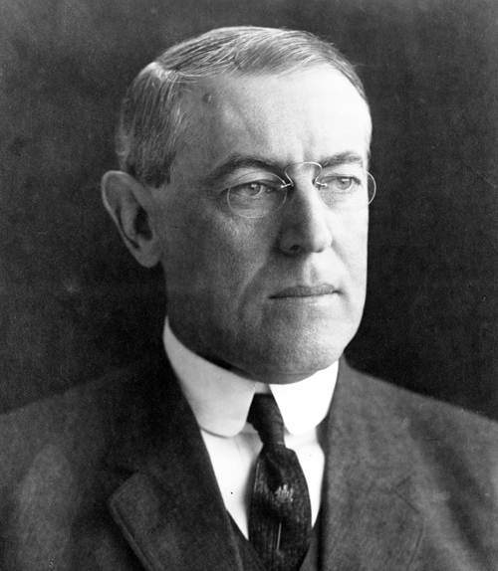
Read Doc A: Woodrow Wilson
Does Wilson think the US should enter WWI? Why or why not?

Slide 18
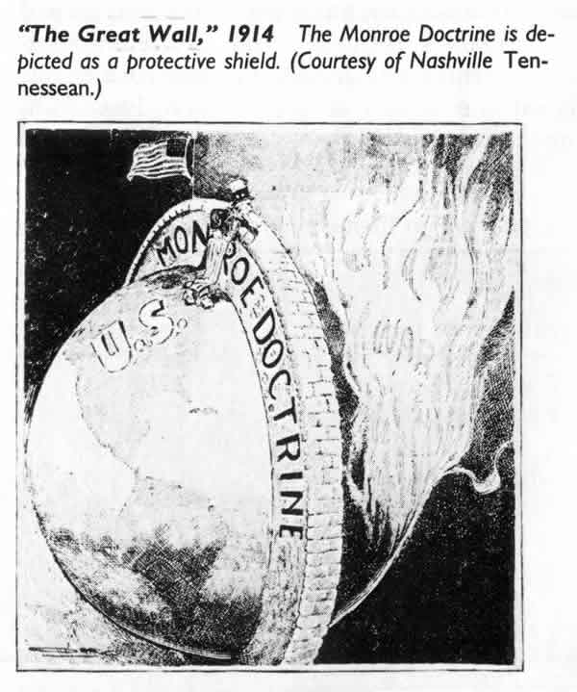
Neutrality
Why did it take so long for America to get involved in the war?
America’s traditional foreign policy was isolationist
“Why should I get involved
in someone else’s problems?”

Slide 19
Hmmm . . .
Is isolationism really an option for a country as powerful as the United States?

Slide 20
British Tactics
British officials worked diligently to gain U.S. support
Example: British cut the trans-Atlantic telegraph cable from Europe to the U.S., making us dependent on British reports of the war

Slide 21
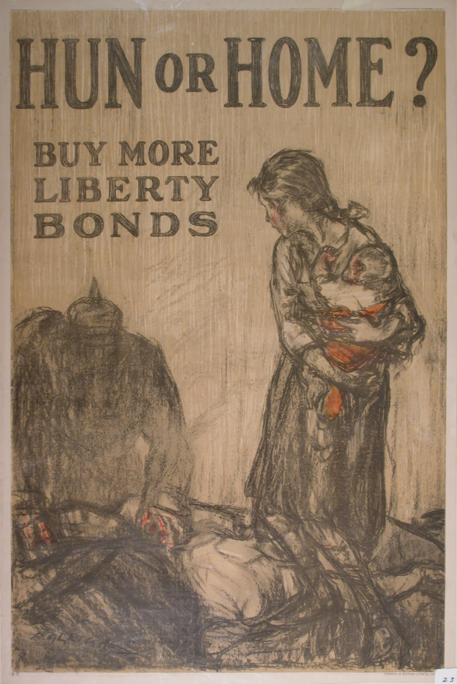
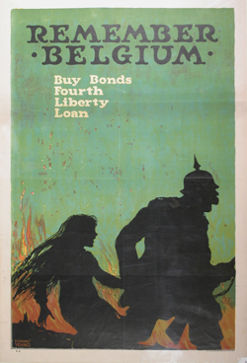
Propaganda
Information designed to influence opinion

Slide 22
Influential Factors
Economic reasons:
American businesses lent over $2 billion to Britain and its allies

Slide 23
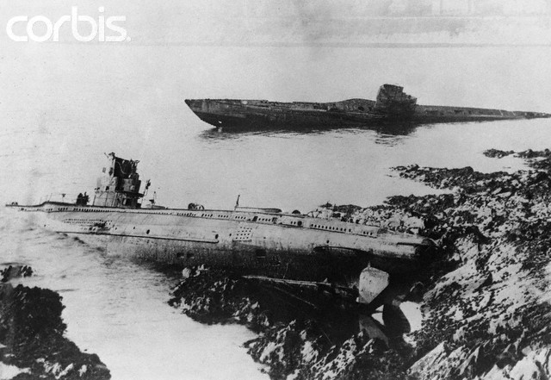
Germany’s Push
U-Boats – huge submarines
1915: Germany announces that they will sink w/o warning any ship they found in the waters around Britain – even civilian ships

Slide 24
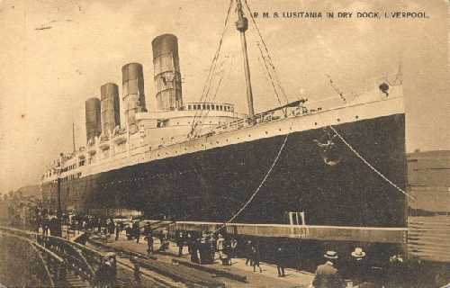
Germany’s Push
Lusitania: British passenger ship

Slide 25
Lusitania
May 7, 1915
Lusitania entered the war zone
German submarine sunk the ship in 15 minutes, killing 1,200 passengers
Including 128 Americans

Slide 26
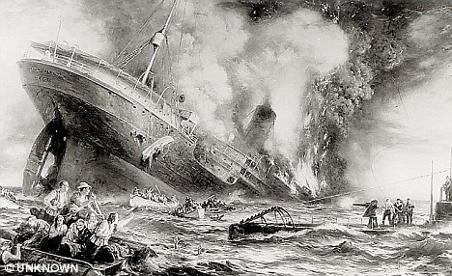
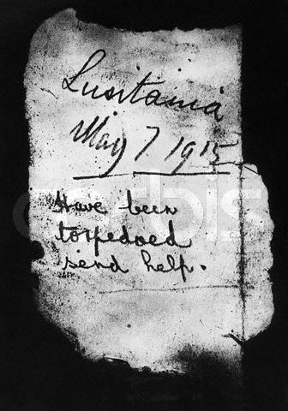

Slide 27
Sussex Pledge (1916)
Germany agrees that they will stop shooting merchant/passenger ships without warning
Keeps the U.S. out of the war a little longer

Slide 28
Read Doc B: Woodrow Wilson
Does Wilson think the US should enter WWI now? Why or Why not?

Slide 29
Zimmerman Telegram
January 1917
Telegram from Germany to Mexico
Intercepted by Britain - America
Contents: if Mexico would become an ally of Germany, Germany would give parts of the U.S. back to Mexico after the war

Slide 30
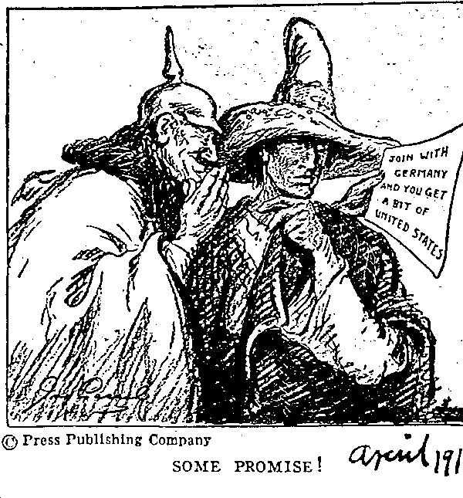

Slide 31
Germany’s Hope
February 1, 1917 – resumed unrestricted submarine warfare
Believed they could starve the British by sinking all supply ships
Thought the U.S. wouldn’t have time to raise and transport an army over to Europe

Slide 32
Early 1917
6 American ships were sunk by the Germans
Zimmerman note + this

Slide 33
The Vote
Senate: 82-6
House: 373 – 50
Outcome: America joins the war

Slide 34
