Slide 1
The Electoral College

Slide 2
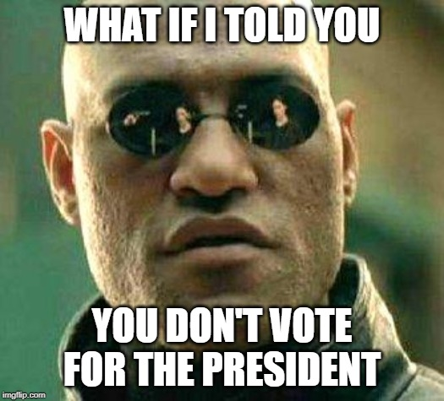

Slide 3
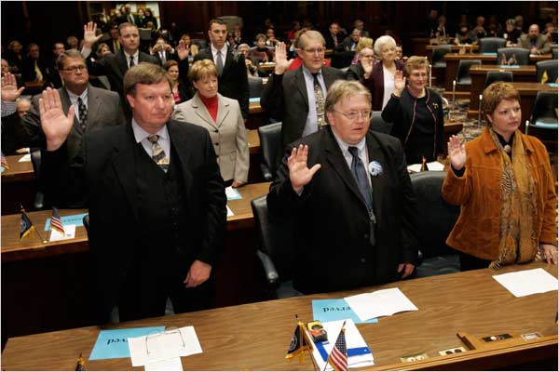
Electoral College: The What
538 electors that get to choose the president
These are who you vote for, basically
“So they have to do what we tell them to.” -Nope
Faithless electors

Slide 4
How does it work?
Each state gets a number of electors equal to it’s Senators + Representatives
Washington D.C. also gets 3 (23rd Amendment)
Whichever candidate wins the popular vote in the state gets ALL the electoral votes for that state
“Winner take all”
2 exceptions: Nebraska and Maine
Whoever gets 270 votes first wins!
“First past the post”

Slide 5
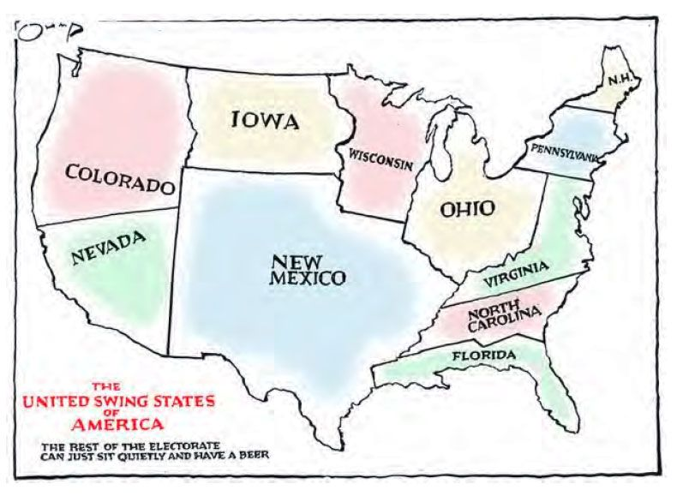
What does it mean?
Does popular vote matter?
Where are presidential candidates going to campaign?

Slide 6
How many times has the president not won the popular vote?
In 1824, John Quincy Adams was elected president despite not winning either the popular vote or the electoral vote. Andrew Jackson received 38,000 more popular votes than Adams, and beat him in the electoral vote 99 to 84. Neither candidate reached the majority 131 votes needed in the Electoral College to be declared president, so the decision went to the House of Representatives
In 1876, Rutherford B. Hayes won the election (by a margin of one electoral vote), but he lost the popular vote by more than 250,000 ballots to Samuel J. Tilden.
In 1888, Benjamin Harrison received 233 electoral votes to Grover Cleveland’s 168, winning the presidency. But Harrison lost the popular vote by more than 90,000 votes.
In 2000, Al Gore garnered about 540,000 more votes than George W Bush. However, Bush won the electoral vote, 271 to 266.
In 2016, Donald Trump won the electoral vote by 304 to 227 over Hillary Clinton, but Trump lost the popular vote. Clinton received nearly 2.9 million more votes than Trump

Slide 7
Electoral College: The why
Why would we create this system in the first place?
The Founding Fathers didn’t think the average American was informed enough to make decisions about the President
Why do we still have it?

Slide 8
Electoral College: Summary
https://www.youtube.com/watch?v=W9H3gvnN468

Slide 9
Alternatives
Proportional Votes: If a candidate gets 80% of the popular vote in a state, they get 80% of that state’s electors, for example.
National Popular Vote: All electors from a state have to vote for the candidate that wins the national popular vote.

Slide 10
Even More Amendments
Stop whining, who thought you wouldn’t learn the Constitution in a government class
12th Amendment- Electors cast one vote for President AND Vice-President, together
23rd Amendment- Washington DC gets 3 votes!

Slide 11
The Big One
Is the electoral college the best way to vote for President in the U.S.? If not, what system should we use and why?
5 paragraph (absolute minimum)
2 sources per paragraph. Include a works cited page.
Should be at least 2 pages
Due on Monday (Nov 24)

