Slide 1
Social Reforms

Slide 2
What’s a Progressive? (Review)
People pushing for reform dealt with problems caused by industrialization and immigration.
Focused on solving crime and political corruption within America

Slide 3
Who were the progressives?
Muckrakers
Journalists/writers who uncover abuse and corruption in a society
Ex. Upton Sinclair
Analogy – raking up the dirt and filth, or muck, on the ground. “Getting the dirt on society”
Nicknamed by President Teddy Roosevelt

Slide 4
Example: Jacob Riis
How is Jacob Riis an example of a muckraker?
How the Other Half Lives: A book of photographs and descriptions that exposed the poor conditions of immigrants and people living in poverty

Slide 5
Picture Analysis
As you look at the following pictures, answer these question on your note sheet:
What do you see in these pictures?
Do you think these photographs are trustworthy accounts of what life was like in American cities during the Industrial era? Why or why not?
How does what you know about Riis change the way you view the first documents that we read?

Slide 6
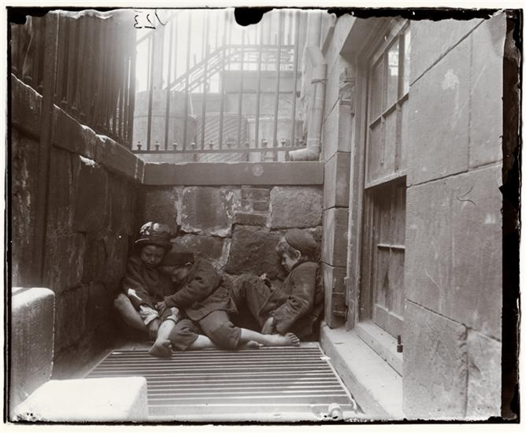
Street Arabs in Sleeping Quarters

Slide 7
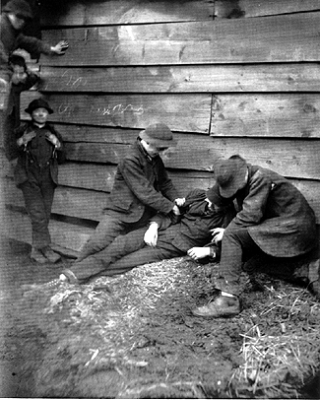
A Growler Gang in Session

Slide 8
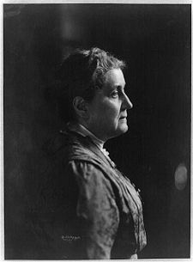
Jane Addams
Founded Chicago’s Hull House
One of the most influential members of the movement
Won the Nobel Peace Prize for her advocacy of racial justice, quality of life issues, infant mortality, and better care for the aged

Slide 9
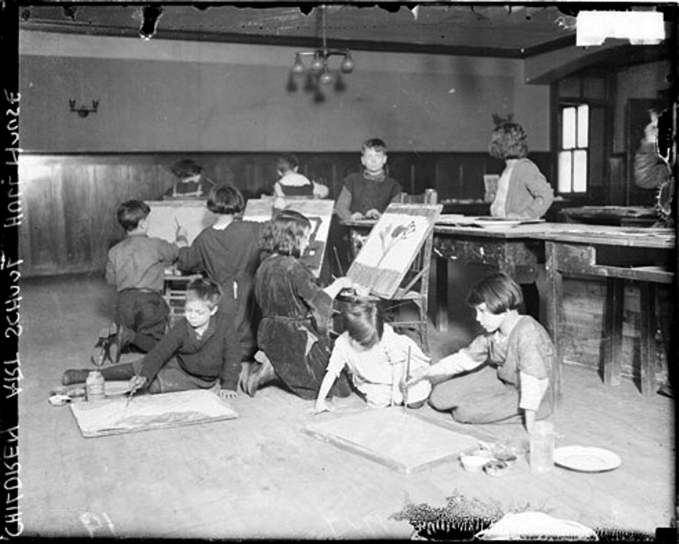
Settlement Houses
Goal of getting the rich and poor in society to live more closely together in an interdependent community
Community centers in slum neighborhoods that provided assistance to people in the area
Over 400 settlement houses
Provided educational, cultural, and social services
Visiting nurses
YMCA

Slide 10
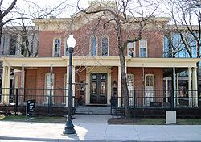
Hull House
Community center where neighborhood societies learn English, talk politics, medical services, nursery for children with working parents, etc.
Chicago

Slide 11
Public Education
1870→ only 2% of all 17 year olds graduated HS
School year was just a few months
Reformers wanted more education to promote cleanliness, thrift, patriotism, hard work, etc.
There is an increase in public education opportunities
1880-1900 → 250 new colleges
More opportunities for women too
$$ unequally distributed between whites and minorities.

Slide 12
Social Darwinism v. Social Gospel
Social Darwinism: “Survival of the fittest.” Do whatever it takes to make money
Social Gospel: Good Christians have a responsibility to care for the poor
Religious movement to help the poor
Gospel of Wealth: Speech by Carnegie encouraging the wealthy to give money back to society

Slide 13
Social Darwinism v. Social Gospel
Using the Venn diagram on your note sheet, answer multiple choice questions 1-6 and then complete the free response question following them

Slide 14
Test prep!
Grab your bright pink Evidence File. Go back through your notes and find examples you can use for each question. USE AS MANY SPECIFIC DETAILS AS YOU CAN FIND!!!!
Start writing a short answer response for each question

