Slide 1
Scarcity and the Study of Econ

Slide 2
Daily Quiz - 1/8/2018
How was your weekend?

Slide 3
Why doesn’t everybody just get what they want?

Slide 4
Scarcity
Simulation 1- In a group of four, plan how you would allocate funds for the prom. You have $8,000 to spend, but you don’t have to spend all of it.
Simulation 2- In your “community,” figure out how you’re going to survive on a desert island, with the resources you’ve gathered. You need to get the things on the next slide.

Slide 5
Scarcity Simulation
NEEDED RESOURCES
FOOD: four 3-inch strips of green paper
SHELTER: 2-inch white square attached to a yellow triangle
CLOTHING: a four-color paper chain
EDUCATION: a four-page book with color cover

Slide 6
Scarcity Simulation
Why was there a difference between groups’ resources?
Which resources were most valuable?
Which were least valuable?

Slide 7
What were the ways that you could get what you needed?
What are ways that we can deal with scarcity?

Slide 8
What is Economics?
Scarcity: the state of being scarce or in short supply; shortage.
Caused because our wants and needs are bigger than our resources
Economy: the wealth and resources of a country or region
Economics: the branch of knowledge concerned with the production, consumption, and transfer of wealth
Market: an area or arena in which commercial dealings are conducted

Slide 9
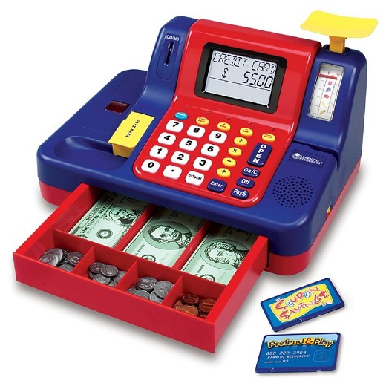
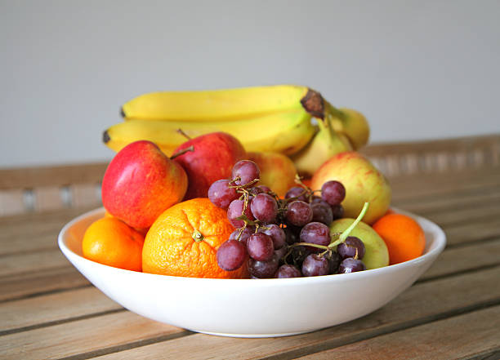
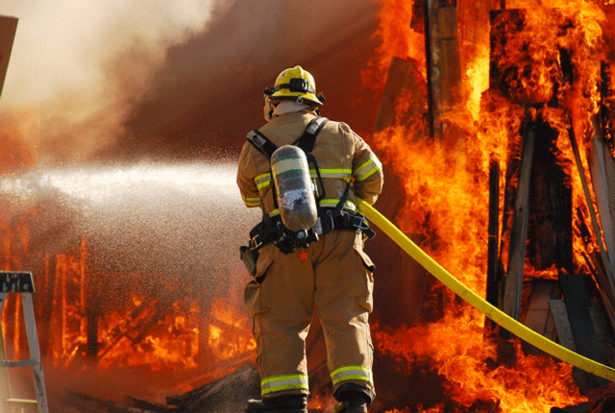
Good or Service?
Goods
Services

Slide 10
Goods or Services?
For each of the following items, hold up a writing utensil if you think it is a good, and raise your hand if you think it is a service.

Slide 11
Getting a Haircut

Slide 12
Tickle Me Elmo

Slide 13
Babysitting

Slide 14
Restaurant

Slide 15
Custom Made Cakes

Slide 16
Tailored Clothing

Slide 17
Key Terms!
Good: Something produced that people can buy (tangible)
Service: Activities done for others for a fee
Want: ?
Need: ?

Slide 18
Scarcity Examples
Find an example from the present day (no earlier than Thanksgiving) of when an individual, business, and government were forced by scarcity to choose how to allocate their resources.

