Slide 1
President’s Roles & The Cabinet

Slide 2
Legislative Branch Review
Four Corners Game
For each question, go to the corner of the room that matches the correct answer
You may trust/follow your classmates, or you may realize that they’re a bunch of dinguses

Slide 3
Regulate Trade
Move Troops
Which of the following is not an expressed power of Congress?
Manage a post office
Pass a budget

Slide 4
House of Reps
Supreme Court
This group holds the powers of impeachment
Executive Branch
The Senate

Slide 5
Age: 30
Citizen: 9 years
Which of these is NOT a requirement to be in the Senate?
Not be a felon
Live in your state

Slide 6
Last Class Review
Walk me through it
Looking at Article II – anything unexpected, any questions?

Slide 7
Roles of President

Slide 8
The Cabinet
One of the best kept secrets of the White House
Super important, but almost nobody knows what it does.

Slide 9
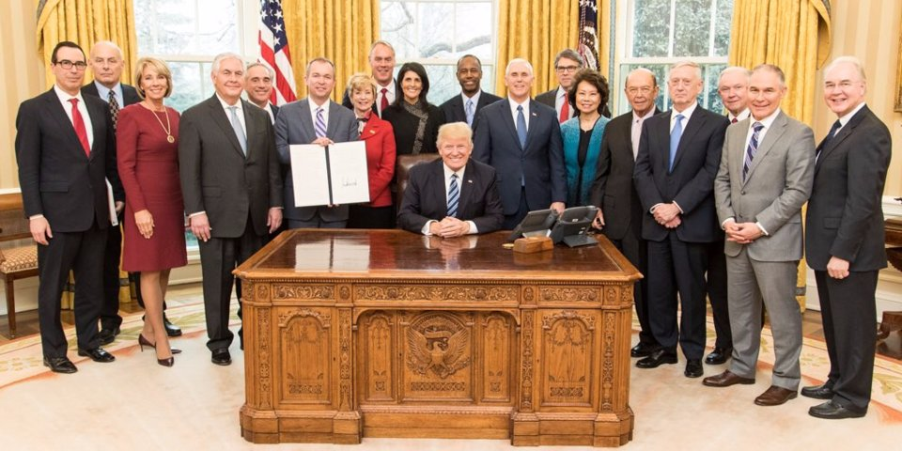
For real though…
Presidential Cabinet: Group of advisors to the President to help him execute his office
Supposedly experts in their field
Cover a variety of topics (you’ll see a list on the next slide)

Slide 10
What sort of things will the President need advice on?
What cabinet positions should he create?

Slide 11
The Current (as of writing) cabinet
Administrator of the Environmental Protection Agency | Andrew Wheeler
Attorney General | William Barr
Director of National Intelligence | Daniel Coats
Director of the Central Intelligence Agency | Gina Haspel
Director of the Office of Management and Budget | Mick Mulvaney
Secretary of Agriculture | Sonny Perdue
Secretary of Commerce | Wilbur L. Ross, Jr.
Secretary of Defense | Mark Esper
Secretary of Education | Elisabeth Prince DeVos
Secretary of Energy | James Richard Perry
Secretary of Health and Human Services | Alex Azar
Secretary of Housing and Urban Development | Benjamin S. Carson, Sr.
Secretary of the Interior | David Bernhardt
Secretary of State | Mike Pompeo
Secretary of Transportation | Elaine L. Chao
Secretary of the Treasury | Steven T. Mnuchin
Secretary of Veterans Affairs | Robert Wilkie

Slide 12
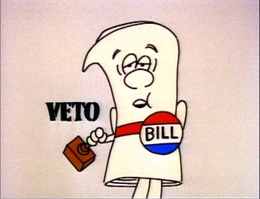
How do the Legislative and Executive Branches interact?
Checks and balances!
How does the executive check the legislative?

Slide 13
Executive Orders
(Technically) Directives given by the President on how to enforce the law
(In practice) Can be about really anything to do with the Executive branch
Can be declared unconstitutional and removed, or Congress can pass laws to invalidate them

Slide 14
Easy-Peasy Assignment
Look up a meaningful Executive Order
Provide the following information on it
Executive Order #
President who signed it
A brief summary of what the order does
An explanation of why it’s an important executive order (if you don’t convince me, I’ll make you do it again!)

Slide 15
Checks and balances tournament

