Slide 1
New Deal Efficacy

Slide 2
Announcements/Reminders
Late Work Due Date?
What’s the schedule for the end of the semester?
You get a study guide, and you get a study guide! Everybody gets a study guide!

Slide 3
Review Questions
Everybody stand up!
To answer the question, you will move to the appropriate corner

Slide 4
Bad Foreign Trade Decisions
The Stock Market Crash
What was not the cause of the Great Depression?
People Purchasing Goods with Credit

Slide 5
The New Deal
The Cyclical Effect
What were the programs created by the gov to fight the Depression called?
Alphabet Agencies

Slide 6
Imports
Exports
Goods made in other countries and brought to America
Tariffs

Slide 7
The Dust Bowl
The Taco Bell
A manmade “natural” disaster that devastated the Great Plains in the 30’s
The Super Bowl

Slide 8
Roosevelt
Hoover
Which President thought that the government should not be the ones providing welfare
(Thanks) Obama

Slide 9
Fireside Chats
“I never saw him—but I knew him. Can you have forgotten how, with his voice, he came into our house, the President of these United States, calling us friends..."
—Carl Carmer, April 14, 1945
Roosevelt would use the radio to give people updates on the state of the nation. He would explain the problems the country was facing and detail his plans to solve them.
He did this 31 times over the course of his presidency

Slide 10
Fireside Chats
The following is one of many letters sent to Roosevelt after one of his fireside chats…

Slide 11
My dear Mr. President: —
I have just listened to your broadcast over the radio and feel that I have to write to you. I must tell you what effect your address to the people has had on me.
I am a member of the graduating class of the Abraham Lincoln High School of Brooklyn, New York and am not eighteen yet. Things aren’t as nice at home as they might be. Bills keep coming in and Dad has to scrape up every cent he can get hold of to pay up. I see the way the world is treating him. With this staring me in the face I was a bit gloomy about my future. However, after listening to your speech, I feel as if there is a silver lining to every cloud. I feel inspired. I feel that if I go to college for more education I will not lose any opportunity that I might find during the four years to go to work. If, I, a high school student, am so affected by your speech you can very well realize how the rest of this country stands behind you.
When the next Election Day rolls around you may rest assured that many of this nation’s youths will march to the polls for the first time and vote for Franklin Delano Roosevelt a second term in office of President of these United States of America.
I am now going to go to bed with a fervent prayer in my heart for you, try and God. May God bless you!
Yours sincerely, Jack Hamovitz

Slide 12
How did Americans respond to the fireside chats, and why do you think they responded that way?

Slide 13
Court Packing
"What is my proposal? It is simply this: whenever a judge or justice of any federal court has reached the age of seventy and does not avail himself of the opportunity to retire on a pension, a new member shall be appointed by the president then in office, with the approval, as required by the Constitution, of the Senate of the United States. That plan has two chief purposes. By bringing into the judicial system a steady and continuing stream of new and younger blood, I hope, first, to make the administration of all federal justice, from the bottom to the top, speedier and, therefore, less costly; secondly, to bring to the decision of social and economic problems younger men who have had personal experience and contact with modern facts and circumstances under which average men have to live and work. This plan will save our national Constitution from hardening of the judicial arteries.”
Franklin D. Roosevelt, Fireside Chat, 1937

Slide 14
Court Packing
What is Roosevelt’s proposal?
Why would he make this proposal?
Do you think his proposal is something the President should do?

Slide 15
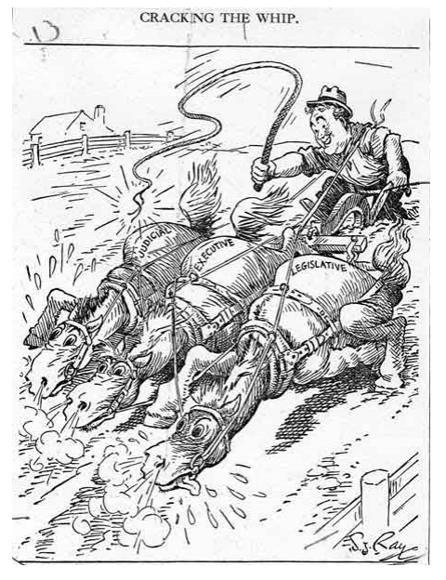
Court Packing- Public Opinion

Slide 16
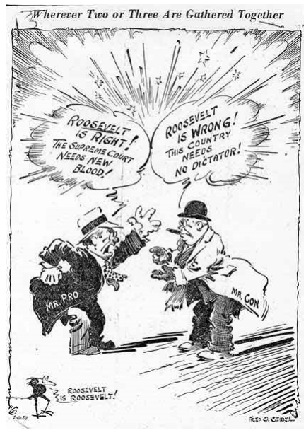
Anotha One

Slide 17
Court Packing- Public Opinion
What did people think of Roosevelt’s court packing proposal?
Why was Roosevelt’s proposal controversial?

Slide 18
New Deal Debate Instructions
You will get into groups of four for this activity
You will then divide into two teams of two- one team will say that the New Deal Programs were effective at fixing the Depression, the other will say they weren’t
Read ALL the documents and choose the best five pieces of evidence that support your side
  Use sourcing to strengthen your arguments

Slide 19
New Deal Debate- The Debate
The group saying the New Deal was a success (Team A) goes first
They present their evidence and the other team (Team B) writes it down. Team B then summarizes the evidence back to Team A
Then switch! Team B presents their evidence, Team A writes it down and repeats it back to Team B

Slide 20
New Deal Debate – Resolution
Now discuss ALL the evidence and as an entire group try to come to a consensus about whether the New Deal was effective
You no longer have to support your assigned side
Individually write a paragraph describing the agreement your group came to. Make sure to use the evidence both sides presented.

