Slide 1
Organized Protest

Slide 2
Voter Registration Activity

Slide 3
I have a dream speech
This is widely regarded as one of the most influential speeches in American history - http://www.americanrhetoric.com/speeches/mlkihaveadream.htm
As you listen take notes of phrases that are moving, powerful or confusing
Also discuss why this is so widely seen as one of the best speeches
Write your own speech about what is needed for a better America, using the same techniques that made the “I Have a Dream” speech so powerful

Slide 4
Civil rights act 1964
Introduced by John F Kennedy
Signed by Lyndon B Johnson
What did it do?
Equal pay for women/blacks
Prohibits discrimination based on gender
Racial quotas in schools (forced busing)
Equal voting rights (no literacy tests/poll tax/etc)
Outlaws discrimination in hotels, restaurants, theaters and more.

Slide 5
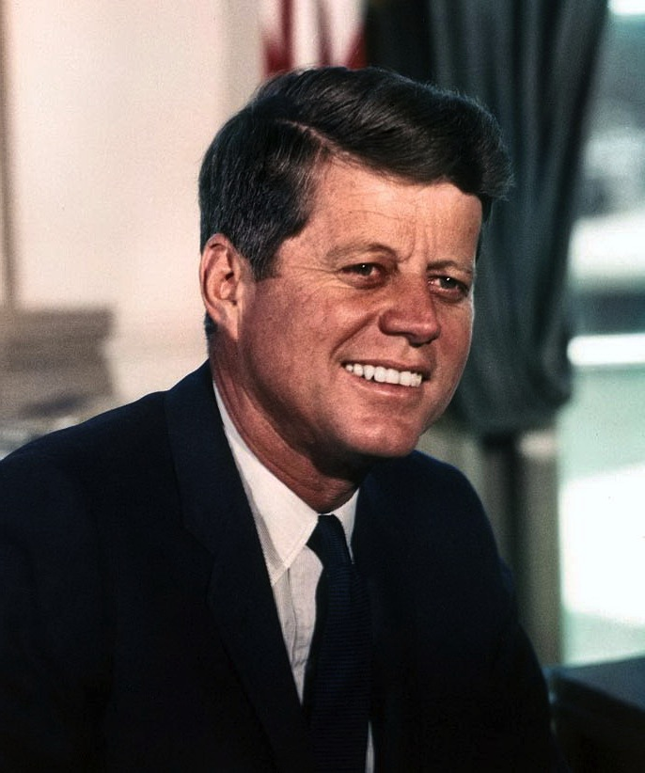
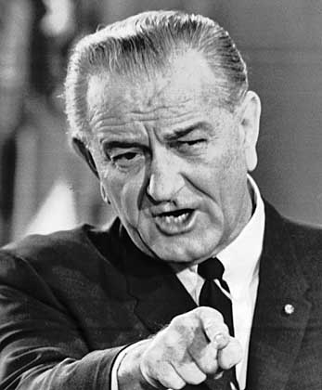
Presidential Influences

Slide 6
Presidential Influences
John F Kennedy-
Originally was unresponsive to the Civil Rights Movement
Changed his mind after seeing news footage of protests in Birmingham, Alabama
Demanded that Congress pass laws protecting equality
Lyndon B Johnson-
Big focus on domestic issues (Great Society)
Pressured Congress to pass Kennedy’s Civil Rights Act

Slide 7
Freedom Riders
Civil rights activists rode buses in mixed racial groups into segregated southern cities
This provoked violent reactions, much of which was endorsed by the police

Slide 8
Freedom riders
On May 14, Mother's Day, in Anniston, a mob of Klansmen, some still in church attire, attacked the first of the two buses (the Greyhound). The driver tried to leave the station, but was blocked until KKK members slashed its tires. The mob forced the crippled bus to stop several miles outside of town and then firebombed it. As the bus burned, the mob held the doors shut, intending to burn the riders to death. Sources disagree, but either an exploding fuel tank or an undercover state investigator brandishing a revolver caused the mob to retreat, and the riders escaped the bus. The mob beat the riders after they got out. Only warning shots fired into the air by highway patrolmen prevented the riders from being lynched…

Slide 9
Freedom riders
That night, the hospitalized Freedom Riders, most of whom had been refused care, were removed from the hospital at 2 AM, because the staff feared the mob outside the hospital. The local civil rights leader Rev. Fred Shuttlesworth organized several cars of black citizens to rescue the injured Freedom Riders in defiance of the white supremacists. The black people were under the leadership of Colonel Stone Johnson and were openly armed as they arrived at the hospital, protecting the Freedom Riders from the mob…

Slide 10
Freedom riders
When the Trailways bus reached Anniston and pulled in at the terminal an hour after the Greyhound bus was burned, it was boarded by eight Klansmen. They beat the Freedom Riders and left them semi-conscious in the back of the bus…
When the bus arrived in Birmingham, it was attacked by a mob of KKK members aided and abetted by police under the orders of Commissioner Bull Connor. As the riders exited the bus, they were beaten by the mob with baseball bats, iron pipes and bicycle chains. Among the attacking Klansmen was Gary Thomas Rowe, an FBI informant. White Freedom Riders were singled out for especially frenzied beatings; James Peck required more than 50 stitches to the wounds in his head. Peck was taken to Carraway Methodist Medical Center, which refused to treat him; he was later treated at Jefferson Hillman Hospital.

Slide 11
Selma and bloody Sunday
https://www.youtube.com/watch?v=x6t7vVTxaic
Civil Disobedience – Breaking unjust laws as a form of protest
Examples?
Read the article in the magazine about the march from Selma to Montgomery and answer the questions in your notes
You may work in groups of up to 3

Slide 12
Voting rights act of 1965
August 6, 1965
Outlawed literacy tests
Sent federal voter registrars to southern states
Was it effective?
The percentage of blacks registered to vote in the state of Mississippi had risen from 6.7% of the population before 1965 to 66.5% by 1969

Slide 13
Journal
What is courage? How is courage demonstrated in the events we’ve learned about that took place during the Civil Rights Movement?

