Slide 1
Judicial 2

Slide 2
Weekly Quiz
Where in the Constitution can you find the information about the Executive branch?
List 3 of the 7 roles of the president
Define the term judicial review
Where did the Supreme Court get the power to declare laws unconstitutional (be specific)

Slide 3
Job Description
9 justices
Serve for life (or until they retire, or get impeached)
Qualifications: Technically – none; traditionally – lawyers, prior judges, Ivy League education

Slide 4
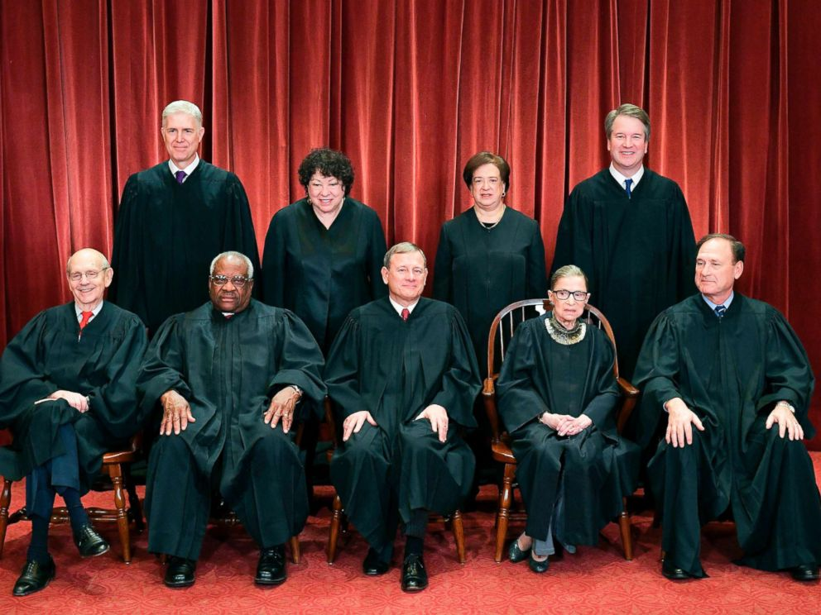

Slide 5
Supreme Court: The Breakdown
3 women, 6 men
1 chief justice (John Roberts), 8 associate justices
5 Conservative, 4 Liberal
Chief Justice Roberts is the swing vote
1 African-American, 1 Hispanic, and a lot of Caucasians

Slide 6
The List
John Roberts
Clarence Thomas
Ruth Bader Ginsburg
Stephen Breyer
Samuel Alito
Sonia Sotomayor
Elena Kagan
Neil Gorsuch
Brett Kavanaugh

Slide 7
Nomination Process
President submits nomination
Senate votes to approve it
Have to give a reason for denying it, not just that they want someone else
If they actually vote on it…

Slide 8
Nomination Process
Merrick Garland Controversy
Republican Perspective: https://www.youtube.com/watch?v=QC_rTJvY3mY
Democrat Perspective: https://www.youtube.com/watch?v=pnwGqkUTsYY

Slide 9
Important Court Cases
Choose a court case from the next slide
Determine what the case was about
Describe how the court decided (including how many people voted each way)
Do you agree with the court’s decision? Not as a matter of personal opinion, but using precedent and the law

Slide 10
Important Court cases
Marbury v. Madison
McCulloch v. Maryland
Gibbons v. Ogden
Dred Scott v. Sandford
Plessy v. Ferguson
Brown v. Board of Education
Miranda v. Arizona
Citizens United v. FEC
United States v. Nixon
Roe v. Wade
Bush v. Gore
Engel v. Vitale
Loving v. Virginia
Obergefell v. Hodges

Slide 11
Important Court Cases
Get into a group of four where each person has a different case
Go through each case and discuss what it was about and whether or not the Supreme Court made the right decision
Fill out your note sheet! At the end of the unit, you will turn in your worksheets on the legislative, executive and judicial branches!

