Slide 1
It Begins!

Slide 2
Welcome Back Quiz!
#SquadGoals
Students will be able to…
Explain how Hitler’s actions led to the outbreak of WWII
Get out a half sheet of paper!
Totalitarianism uses what to control people?
Write a thesis statement for this prompt: How was Hitler able to come to power in Germany?
What’s your school-related New Year’s resolution?

Slide 3
Lightning Round!
We’re going to fly through this quickly to get caught up. If you didn’t get the notes between classes, you still need to get them on your own time!

Slide 4
Italy
One of the 1st Dictatorships
Benito Mussolini
Founded Italy’s Fascist Party
Pledged to return Italy to Glory days of Roman Empire
Promised Working Class full employment and social security

Slide 5
Italy
Fascism
Aggressive NATIONALIST – considered the Nation more important than the individual
Nations become great through building an empire – MORE LAND
ANTI – COMMUNIST

Slide 6
Russia
After Bolshevik Revolution – Communist Party led by Vladimir Lenin
Renamed USSR in 1922 (Union of Soviet Socialist Republics)
Stalin
1902 – 1913 – imprisoned or expelled 7 times
1926 – becomes Russian Soviet Dictator
Begins massive industrialism in Russia – harsh conditions and lower wages
Tolerated no opposition

Slide 7
Russia
Communism in Russia
Instituted one- party rule
Suppressed individual liberties
Punished opponents

Slide 8
Germany
Upset at the Treaty of Versailles
Horrible economy
Hitler
One of the 1st recruits for Nazi Party
1923 – tried to seize power – failed – jailed
Wrote Mein Kampf –
Aryans are master race, blue eyes, blonde hair, we didn’t deserve what we got after WWI, etc.
Appointed Chancellor – called for new elections and he won!

Slide 9
Germany
Nazi Germany
Anti – Communist
Didn’t follow the treaty
Wanted to expand Germany
Intimidated voters
People followed because it gave them hope and many promises given

Slide 10
Japan
Difficult economic times
Japan had to import all goods but they couldn’t afford them
Started tariffs but that backfired too
Blamed corrupt politicians – said democracy was bad and was ‘un-Japanese”

Slide 11
Japan
Only way to survive would be to invade and get more land
1931 – invaded Manchuria (North China)
Japanese Prime Minister interfered, Japan officers assassinated him
From that point forward – Military (Hirohito) controlled the government.

Slide 12
Hitler’s Timeline Map
http://www.nationalarchives.gov.uk/education/worldwar2/theatres-of-war/western-europe/1939/

Slide 13
The Austrian Anschluss
In 1937 Hitler called for the unification of the German people (Hitler wants more land)
First place: Austria
Hitler announces the “union” of Austria and Germany

Slide 14
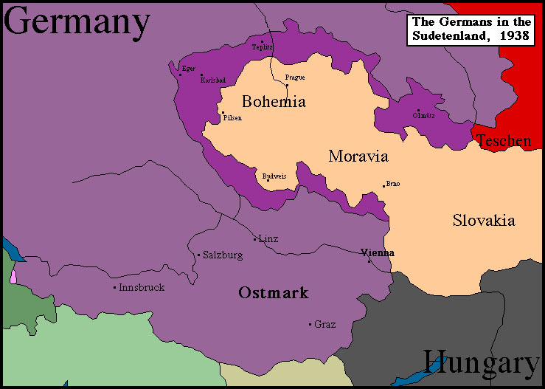
Hitler’s Demands
Hitler next demands the Sudetenland, an area of Czechoslovakia with a large German-speaking population

Slide 15
The Munich Agreement
European leaders start worrying
Representatives of Britain, France, Italy, and Germany agreed to meet in Munich to decide Czechoslovakia’s fate (the Munich Conference)
Appeasement: agreed to Hitler’s demands
Concessions in exchange for peace
Why?
Hitler has few demands – give him what he wants and we can avoid war

Slide 16
Primary Source Activity
Document A & B (Pages 2-3 in Doc Book)
Read each document and answer the corresponding questions on your notes.
Appeasement Hypotheses –
#1 – Write a paragraph answering Hypotheses #1
Final Essay Prep - What should that paragraph include?

Slide 17
British Prime Minister: Neville Chamberlain
Neville Chamberlain:
Returning home, he promised “a peace with honor, a peace in our time”
Churchill, very upset:
“Britain and France had to choose between war and dishonor. They chose dishonor. They will have war.”

Slide 18
The Nazi-Soviet Pact
Non-aggression pact: August 1939
Germany and Russia promised never to attack each other
Another pact (secret) to divide Poland between them

Slide 19
Map 2: 1938

Slide 20
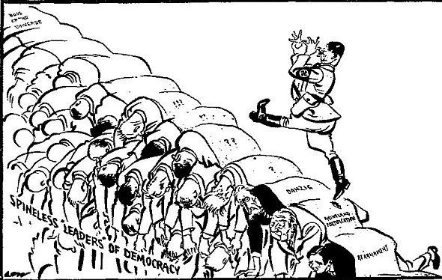
The German Offensive Begins
Did appeasement work?
In March 1939, Hitler takes over the rest of Czechoslovakia
Hitler invaded Poland on September 1, 1939.
Two days later Britain and France declared war.

Slide 21
A. Blitzkrieg in Poland
Blitzkrieg – lightning war
Tanks, artillery, and soldiers, moving by truck instead of on foot, rapidly struck deep into enemy territory before the enemy could react.
German troops took Poland in less than a month.
This was used to also take Denmark, Norway, Belgium, the Netherlands, and France.

Slide 22
Map 3: Sept 1939

Slide 23
The Phony War
For several months afterward, war was at a standstill along the Maginot Line along the French Border.
Called the “phony war” because no one fought for several months.
Suddenly, on April 9, 1940, Hitler launched a surprise invasion of Denmark and Norway
He next turned to Belgium and the Netherlands, which he overtook by the end of May

Slide 24
Map 4: April 1940

Slide 25
Map 5: May 1940

Slide 26
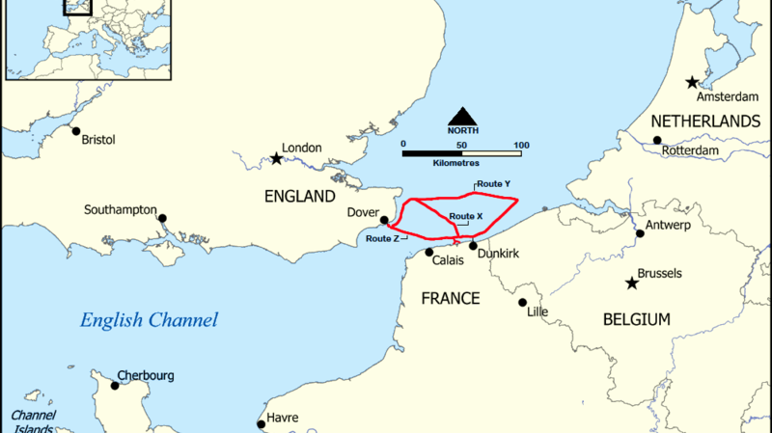
Dunkirk Evacuation
Troops landed in England from Dunkirk,
Beach Harbor Total
27 May – 7,669 7,669
28 May 5,390 11,874 17,804
29 May 13,752 33,558 47,310
30 May 29,512 24,311 53,823
31 May 22,942 45,072 68,014
1 June 17,348 47,081 64,429
2 June 6,695 19,561 26,256
3 June 1,870 24,876 26,746
4 June 622 25,553 26,175
Totals 98,671 239,555 338,226

Slide 28
The Fall of France
Germans came through Belgium to attack France
British and French troops barely escape
Italy joins on the side of Germany and invades France from the South
France was quickly overtaken

Slide 29
Map 6: June 1940

Slide 30
The Battle of Britain
Hitler tried to use the Luftwaffe (Air Force) to destroy Britain’s ability to resist.
1,000 planes a day bombed Britain.
RAF pilots flew as many as six and seven missions a day.
“Never in the field of human conflict was so much owed by so many to so few.”

Slide 31
Exit Slip
At what point would it have been appropriate for other countries to interfere with Germany’s expansion? Why is the time you’ve chosen ideal?
Expectations: at least 3 complete sentences, identifying a time period and providing justification

