Slide 1
Holocaust Day

Slide 2
Historical Timeline
1930
September 14, 1930 - Germans elect Nazis making them the 2nd largest political party in Germany.
1933
January 30 - Adolf Hitler becomes Chancellor of Germany.
April 1 - Nazis begin boycott of Jewish owned shops
July 14 - Nazi Party declared Germany's only political party.
1934
August 2 - German President Hindenburg dies.
August 19 - Adolf Hitler becomes Führer of Germany.
1935
March 16 - Hitler violates the Treaty of Versailles by introducing military conscription.
September 15 - German Jews stripped of rights by Nuremberg Race Laws.
1938
November 9/10 - Kristallnacht - The Night of Broken Glass.
1939
January 30, 1939 - Hitler threatens Jews during Reichstag speech.
September 1, 1939 - Nazis invade Poland.

Slide 3
Antisemitism
Hatred of the Jewish race (anti-semitism) is not a new concept. By WWII, it had been around for over 2,000 years.
First account is in 3rd Century BC Egypt
Holocaust and preceding events were the largest scale of antisemitism in human history.

Slide 4
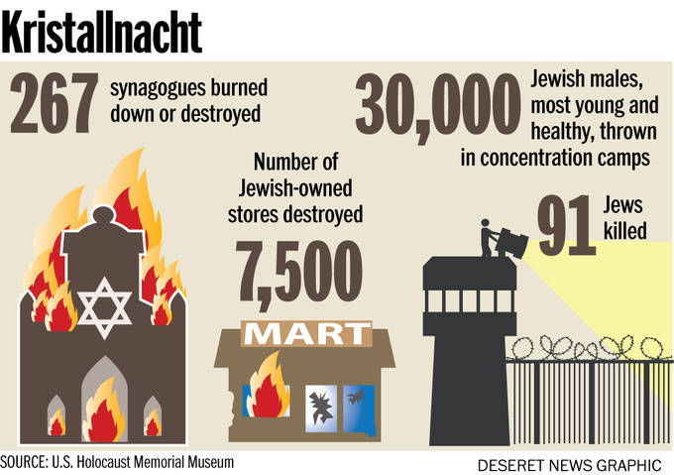
Kristallnacht
November 9-10, 1938

Slide 5
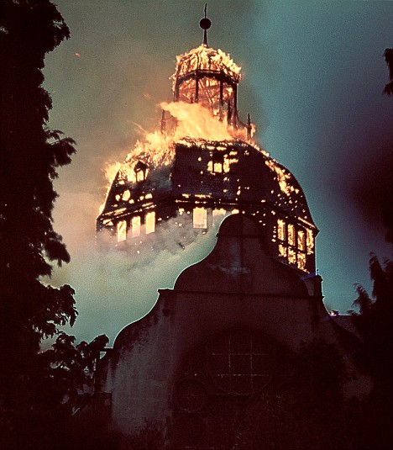
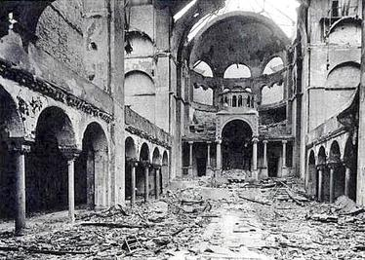
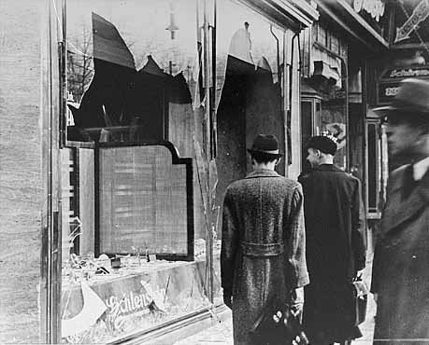

Slide 6
Holocaust Casualty Totals
Jews: up to 6 million
People with disabilities living in institutions: up to 250,000
Roma (Gypsies): 196,000–220,000
By location
Auschwitz complex (including Birkenau, Monowitz, and subcamps): approximately 1 million
Treblinka: approximately 925,000

Slide 7
Nasser’s Story

Slide 8
Holocaust Project Instructions
Read at least 3 of the stories of Jews during the Holocaust
You will make a “Creative Project” illustrating your response to the stories you read and the Holocaust in general
No phones today – put ‘em in the bin!
Use your time effectively. You have this class to make your project so that we can present them next time!

