Slide 1
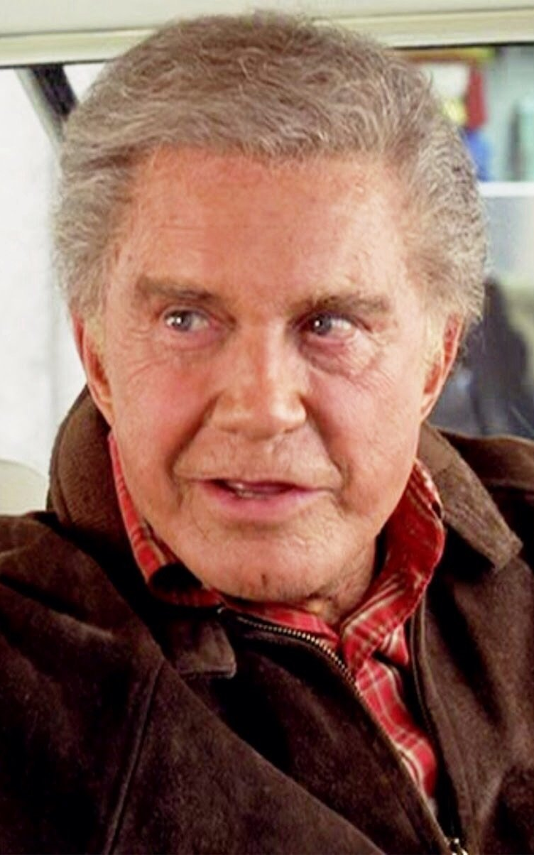
Unit 4: Civil Responsibility

Slide 2
Bellringer - 11/12/2019
What is the responsibility of a good citizen in America’s democracy? List ways that individuals should participate in society.
Note: I’m not asking what people do, I’m asking what they should do

Slide 3
Class Tally
If something on your list isn’t already on the board, write it in the middle column
Put a tally on the left of anything that was on your list
Put a tally on the right of anything you disagree with

Slide 4
Why don’t people participate?

Slide 5
Voting

Slide 6
Who can vote?
What are the requirements to vote in the United States right now (November 12, 2019)?
Who actually does it?
US Voter Turnout Data: https://www.fairvote.org/voter_turnout#voter_turnout_101
Comparatively: https://www.pewresearch.org/fact-tank/2018/05/21/u-s-voter-turnout-trails-most-developed-countries/

Slide 7
History of voting rights
Easy Question: Has the US always allowed “everyone” to vote?
What are some groups that have been disenfranchised in the past?

Slide 8
Timeline of being less of a jerk (not to scale)
Rich*, white men (1789)
Men of all races (1868)
Women (1920)
Adults 18-21 (1971)
Not-rich*, white men (1820ish)
All races, but for real (1965)
Chinese immigrants (1943)
Native Americans who leave their tribe (1887)
All Native Americans (1924)
*Land-owning

Slide 9
Is getting the right to vote easy?
What did those groups have to go through to get the right to vote?
https://www.youtube.com/watch?v=3HdQ0iVrl2Y
https://www.youtube.com/watch?v=XST4lV7HnO8
These short clips don’t even come close to the whole story. Even if that was all I did in class today, I wouldn’t be able to do it justice.

Slide 10
Why did they do it?
Why did these groups fight for the right to vote? Nobody does it anyway

Slide 11
Absolutely unrelated change of pace

Slide 12
Citizenship test
Ya’ll gotta pass this to graduate!
It’s a huge part of your grade (1 point when completed)
You can take it multiple times, no penalty for retakes
The Website: alpine-civics.org

Slide 13
The Process

Slide 14
Registration
Before you can vote, you have to register (so the state can provide enough polling places)
Easiest to remember resource: vote.utah.gov
We’re all gonna do it!

Slide 15
Election Day
It’s actually super easy
Find out where your polling place is
Show up (with ID)
Wait in line
Press the button
Get a sticker

