Slide 1
Seating Chart?
Today your sitting arrangement is determined by your birthday. The person with the birthday closest to (but not before) January 1 sits in Seat 1. Fill in from there.
Year doesn’t matter
Don’t skip seats!
The person in seat 5 will let me know when you’re ready to be checked off

Slide 2
Government: The Basics

Slide 3
Pop Quiz!! (I Warned you…)
One of the requirements of the class is to pass a citizenship test. Let’s see how you would do
Grab a stack of 5 flashcards and quiz a partner
Not going into Skyward, stop freaking out.

Slide 4
STORY TIME!!!

Slide 5
Some Key Terms
Limited Government: the government can only do what it is explicitly told to do
What tells the government what it can do?
Separation of Powers: splitting up the responsibilities of the government between different groups
How many branches?

Slide 6
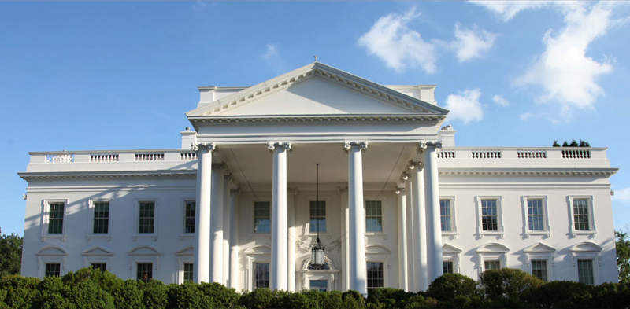
Executive Branch
Made up of: President, Vice-president, the Cabinet, independent federal agencies
Purpose: Enforce (Carry out) the laws

Slide 7
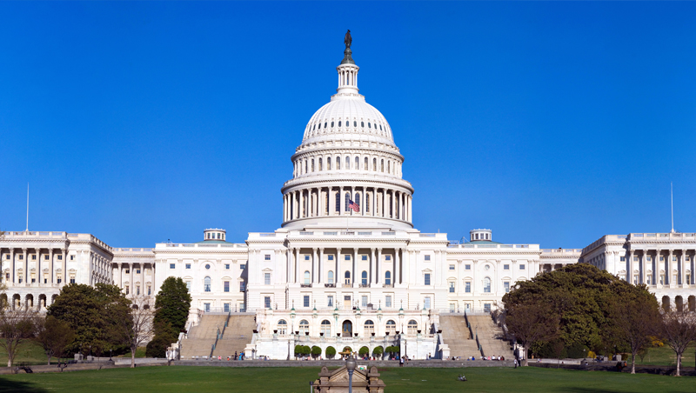
Legislative Branch
Made up of: Congress (House of Representative and Senate)
Purpose: Make the laws

Slide 8
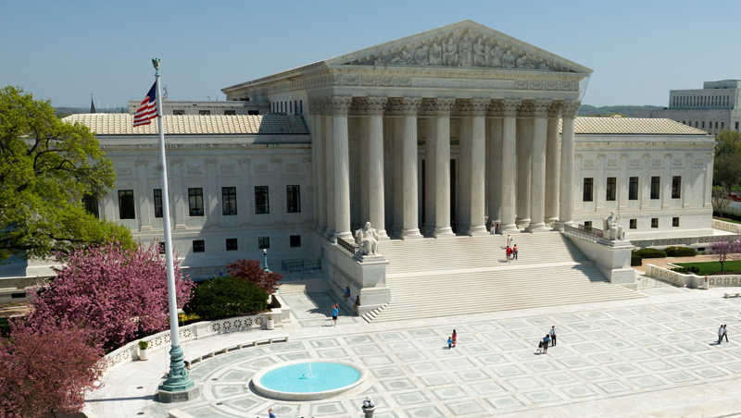
Judicial Branch
Made up of: Supreme Court, other federal courts
Purpose: Interprets the laws (makes sure they follow the Constitution

Slide 9
Why?

Slide 10
Checks and Balances
Definitition: A set of powers given to each branch of the government to stop the others from becoming too powerful
Works because of a principle called rule of law
Everyone, even the people in power, has to follow the law
How do the branches check each other?

Slide 11
Checks and balances
Executive>Judicial | Nominates Justices
Executive>Legislative | Veto Power Executive Orders
Legislative>Judicial | Approves nominations Impeachment Pass constitutional amendments
Legislative>Executive | Overriding vetoes Impeachment Controls the budget
Judicial>Legislative | Declares laws unconstitutional
Judicial>Executive | Declares Executive Orders unconstitutional

Slide 12
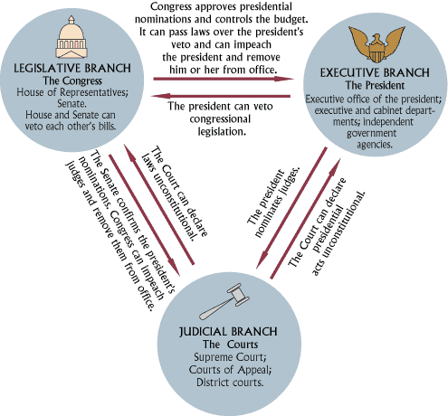
A Way simpler version I found after I spent too long making the previous table

Slide 13
Review
Schoolhouse Rock: https://www.youtube.com/watch?v=T_foQoCHQq8

Slide 14
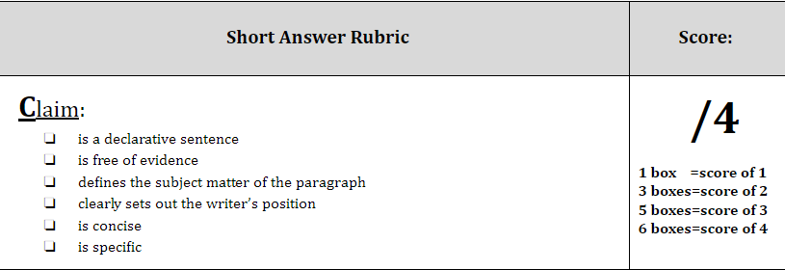
Exit Slip
Write a claim statement for the following question:
“Which branch of the federal government is the most powerful?”

