Slide 1
Labor & Factory Workers

Slide 2
Daily Quiz – 9/6/17
OBJECTIVE:
☐ I can describe challenges faced by factory workers.
☐ I can explain how children were exploited for labor.
☐ I can analyze the relationship between industry and the working class.
1. Explain the difference between new immigrants and old immigrants
2. How did ethnic cities help immigrants transition to life in the US?
3. Give two reasons for urbanization in the United States during the Gilded Age

Slide 3
EXAMPLE #1 The Bitter Cry of the Children
Close Reading:
Fill out the rubric as you silently read the excerpt
For the skills portion of your test, you will do exactly this!
Answer the questions under the rubric, using specific evidence from the reading

Slide 4
Life as a Factory Worker
How did life as a factory worker differ from life working in a small shop?
Relationship with boss
Relationship with product

Slide 5
The Work Environment
Factory workers worked by the clock – up to 16 hours a day, sometimes 7 days a week.
Workers could be fired for being late, talking, or refusing to do a task.
Workplaces were often unsafe.
Children often performed unsafe work and worked in dangerously unhealthy conditions.

Slide 6
Thinking of Complaining?
Many companies required workers to take oaths or sign contracts promising not to join a union.
They hired detectives to identify union organizers.
Workers who tried to organize were fired and placed on a blacklist, and no one would hire them.

Slide 7
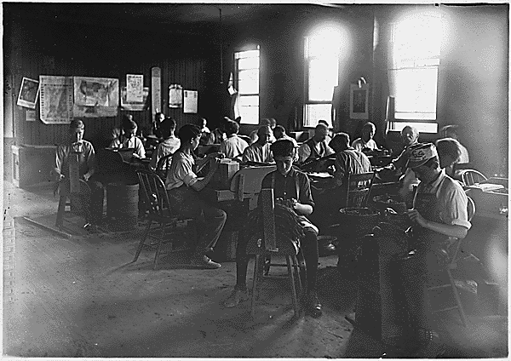

Slide 8
Working Families
In the 1880s, children made up more than 5% of the industrial labor force.
Children often left school at the age of 12 or 13 to work
Girls sometimes took factory jobs so their brothers could stay in school.
If an adult became to ill to work, children as young as 6 or 7 had to work.

Slide 9
Working Families
Rarely did the government provide public assistance, and unemployment insurance didn’t exist.
The theory of Social Darwinism held that poverty resulted from personal weakness. Many thought that offering relief to the unemployed would encourage idleness.

Slide 10
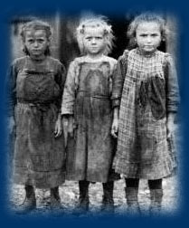

Slide 11
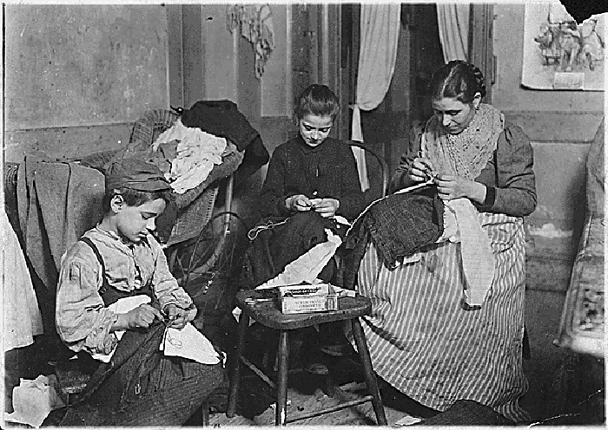

Slide 12
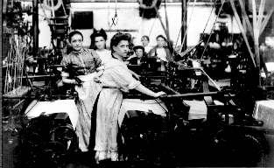

Slide 14
EXAMPLE #2 The Triangle Shirtwaist Factory Fire
The Story:
https://www.awesomestories.com/asset/view/Triangle-Shirtwaist-Fire
Spoiler Alert:
Not an “awesome story”

Slide 15
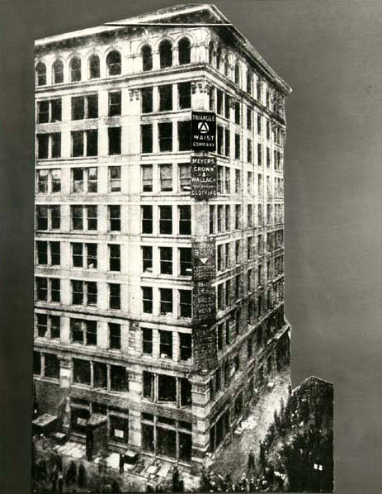

Slide 16
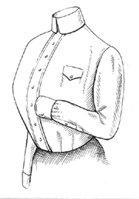

Slide 17
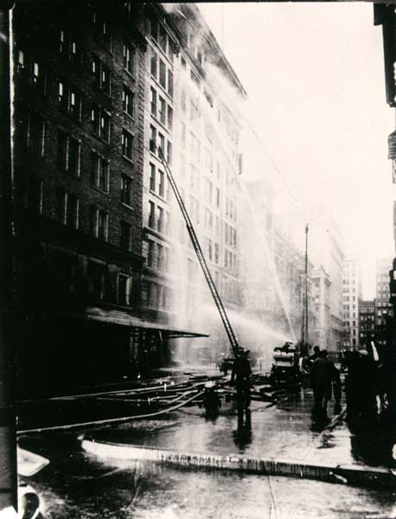

Slide 18
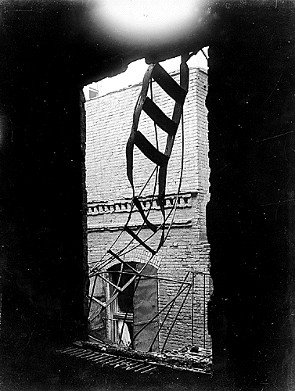

Slide 19
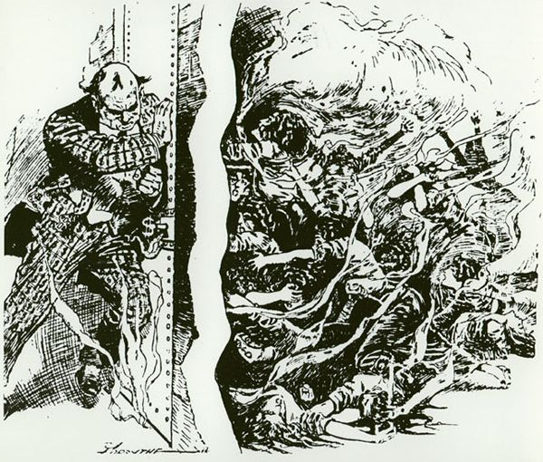

Slide 20
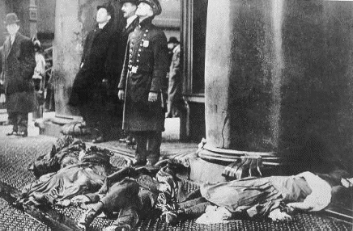

Slide 21
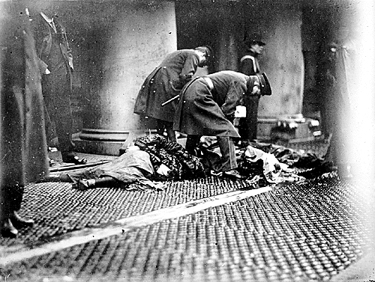

Slide 22
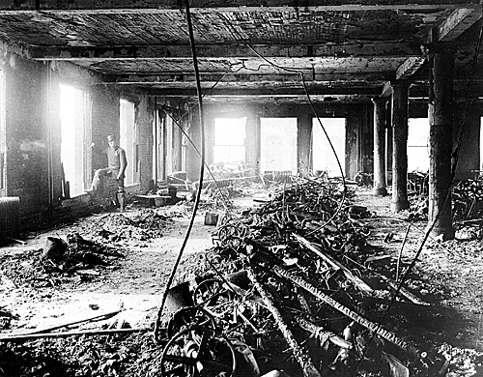

Slide 23
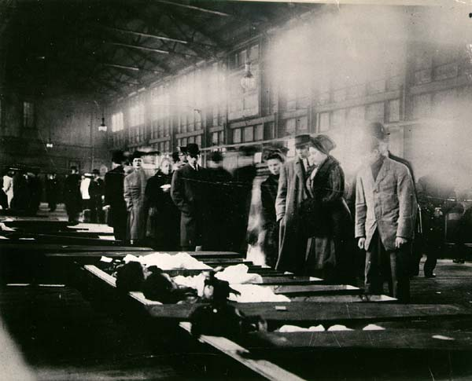

Slide 24
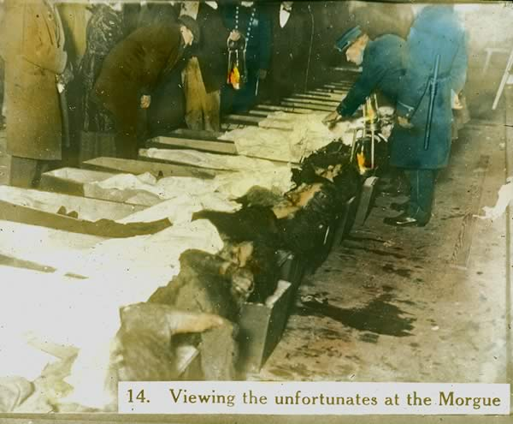

Slide 25
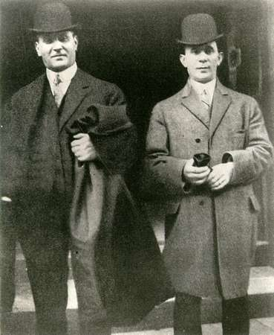
The Aftermath
March 25, 1911
146 died
Max Blanck and Isaac Harris acquitted
Their factory with the exact same conditions opens several months later

Slide 26
EXAMPLE #3 Meat Packing Plants
http://www.youtube.com/watch?v=h2ppaJwQ9UM
Upton Sinclair
Wrote The Jungle
Exposed the unsanitary meat-packing industry
Exposed harsh working condition too

Slide 27
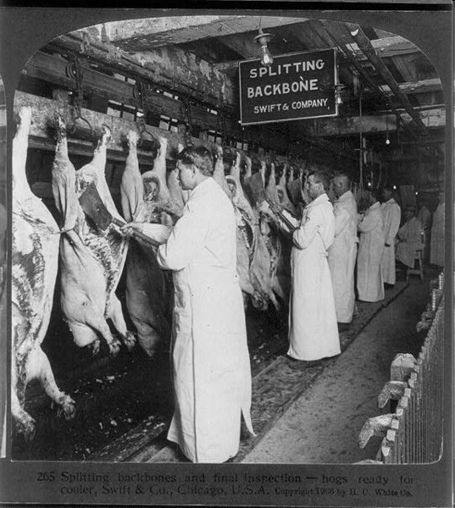

Slide 29
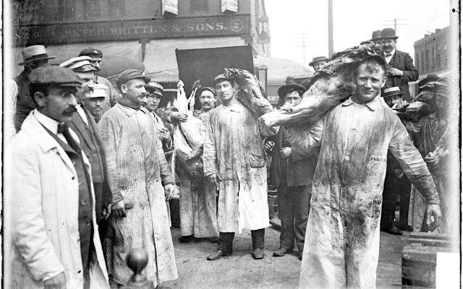
“The Jungle”
Read the excerpt from “The Jungle”
Answer the questions associated with the text

