Slide 2
Weekly Quiz
Which branch of government enforces the laws?
List 1 power of the Executive Branch and one power of the Legislative Branch (label which is which)
List two cabinet positions
What is the term for dividing Congress into two houses? (We have a ________________ legislature)

Slide 3
Citizenship Practice
Choose a flashcard out of my box (you want one that is difficult!)
Go around the room and quiz people with your flashcard. If they don’t know the answer, they’re out!
Once you’re out, go back to your seat and sit down
Last one standing wins (in case of a tie, Bird will rapid fire random questions from the box; first to answer wins)

Slide 4
Current Events Update
What’s been released
Quid pro quo
What are we doing no?

Slide 5
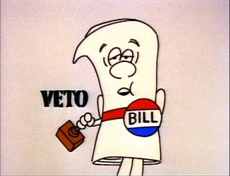
How do the Legislative and Executive Branches interact?
Checks and balances!
How does the executive check the legislative?

Slide 6
Executive Orders
(Technically) Directives given by the President on how to enforce the law
(In practice) Can be about really anything to do with the Executive branch
Can be declared unconstitutional and removed, or Congress can pass laws to invalidate them

Slide 7
Executive Orders – Examples
Order 9066 – Moved Japanese into internment camps
Emancipation Proclamation – Freed slaves in southern states
Order 13767 – Build a border wall with Mexico

Slide 8
Easy-Peasy Assignment
Look up a meaningful Executive Order
Provide the following information on it
Executive Order #
President who signed it
A brief summary of what the order does
An explanation of why it’s an important executive order (if you don’t convince me, I’ll make you do it again!)

Slide 9
Roles of President

