Slide 1
The Establishment of Israel
A Brief History

Slide 2
Turn and Talk
At what point is it okay for the U.S. to get involved in conflicts between two other countries?

Slide 3
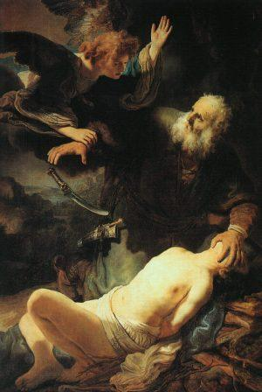
Israel
1800 BCE – Hebrews: nomadic tribes from Canaan (present day Iraq)
Hebrews considered themselves the chosen people: direct descendants of Abraham and Isaac as opposed to Arabs who believe themselves to be direct descendants of Abraham and Ishmael
Hebrew belief was Monotheistic - Judaism (Jews)

Slide 4
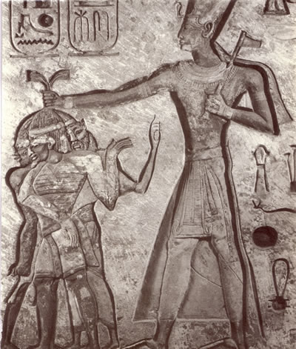
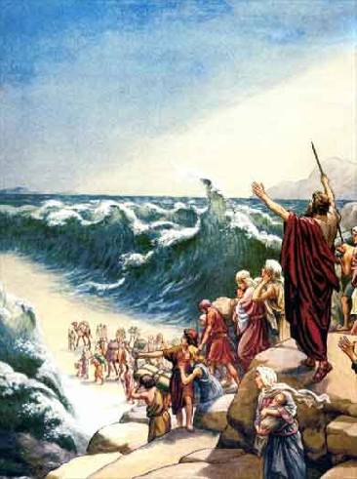
1500 B.C.E. – Hebrews moved to Egypt because of a drought– used by Egyptians as a work force.
1250 – Moses led Hebrews back to Canaan (across Sinai)
1025 – Formed Kingdoms of Judea and Israel. Kings David and Solomon build the first temple in 1000 BCE

Slide 5
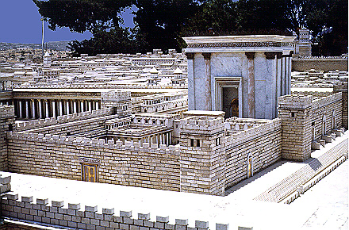
586 B.C.E - Conquered by Babylonians –1st temple destroyed – first Diaspora (scattering of people)
539 BCE - Babylon falls to Persian Rule (Cyrus)
300 BCE Persians allowed Hebrews back - built a second temple (165 BCE.)
Projected model of the 2nd Temple
Wailing Wall – the remaining remnants of the 2nd Temple.

Slide 6
70 CE Romans destroyed Jerusalem and the second temple - second Jewish Diaspora (scattering Jews to other parts of the world).
Romans renamed the area Syria Palaestina (after the Hebrew enemy Philistines)

Slide 7
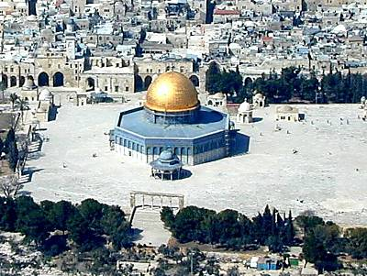
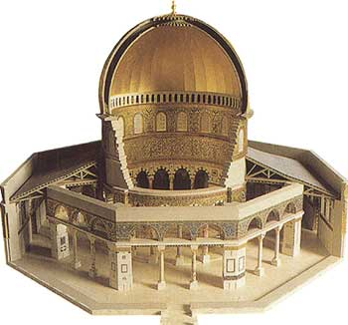
313 CE Christianity centers in Jerusalem (due to Roman Emperor Constantine)
639 CE – Muslim Arab armies capture Jerusalem – build the Dome of the Rock
1096 CE Pope sends men to recapture the Holy Land (Crusades). Christians did not defeat the Arabs.
1516 – 1917 Ottoman Turks (Muslims) take over Palestine.
The Dome of the Rock

Slide 8
What is each religions claim to the Holy Land?

Slide 9
Culture v. Religion
Sometimes people confuse culture and religion when talking about the issues in the Middle East, since terms can get used interchangably.
“Arab” describes a culture (predominantly Muslim)
“Jew” or “Hebrew” can describe both a culture and a religion
Is there such thing as a Jewish Arab?

Slide 10
Late 1800’s: Zionism – a movement among European Jews to set up a Jewish homeland in Palestine.
Persecution of Jews (Anti-Semitism) became rampant in Europe due to: Jews kept to themselves in communities, churches, usury.

Slide 11
WWI: The Ottoman Empire sided with Germany and Austria Hungary
Britain’s promises:
1.Arabs land in Palestine if they help fight the Ottomans.
2. Jews a national homeland in Palestine for Jewish support during the War.
(Balfour Declaration)

Slide 12
WWII 1930-40’s: Nazis rise to power – many Jews fled to Palestine
Result of WWII – Palestine turned over to the United Nations in 1947.

Slide 13
United Nations – Oct 1945
The UN has 4 main purposes
To keep peace throughout the world;
To develop friendly relations among nations;
To help nations work together to improve the lives of poor people, to conquer hunger, disease and illiteracy, and to encourage respect for each other’s rights and freedoms;
To be a centre for harmonizing the actions of nations to achieve these goals.
Biggest one? Preventing global conflict

Slide 14
UN Security Council (a.k.a. The one people care about)
Permanent Members:
USA
China
United Kingdom
France
Russia
15 Members: five permanent members with veto power and ten non-permanent members, elected by the General Assembly for a two-year term.
Meetings are called at any given time when the need arises.
Rotating Presidency: Members take turn at holding the presidency of the Security Council for one month.

Slide 15
What should be done with Palestine after WWII?
REMEMBER: Jews have been scattered, they were promised the Holy Land. The Muslims currently live in the Holy Land...they are arch enemies to the Jews.
Think about what would be best for both groups of people currently claiming the land
Come up with a proposal of a solution to this question... You have 10 minutes.

Slide 16
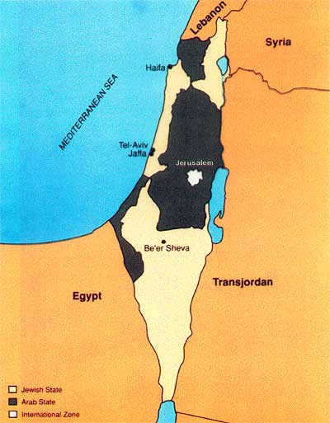
1947 United Nations Partition Plan: The U.N. splits Palestine into a Jewish state and an Arab state.
Arabs object to giving any territory to Jews.
What issues can you foresee with the partition plan?

Slide 17
1948 Israeli War for
Independence
Jews announce the creation of Israel.
Arab nations declare war at once, and military forces are sent.
1949 - Israel defeats Arab forces with the help from the U.S. Armistice is called by UN. UN annexes almost half the area set aside for Arabs under the UN partition plan + half of Jerusalem. Jordan gets West Bank, Egypt gets Gaza Strip, and Syria gets Golan Heights.
Arab refugees flee to those three areas.

Slide 18
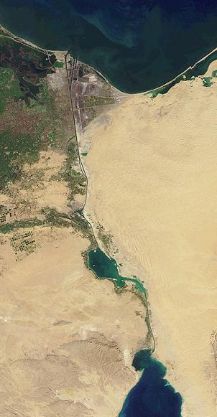
1956: Egypt nationalizes Suez Canal (completed by French in 1869, then controlled by Britain because of access to Indian colony)
Egypt blocks Israel’s use of the Suez Canal
Israel, Britain and France attack Egypt. Conflict ends in a UN cease fire.

Slide 19
1964: Creation of the PLO ( Palestinian Liberation Organization). The primary goal – a state for Palestinian Arabs. Leader was Yasser Arafat.

Slide 20
1967; The Six-Day War – Israel initiates a strike on Egyptian air force on the ground – destroys them
Israel captures East Jerusalem and the West Bank from Jordan, the Golan Heights from Syria, the Gaza Strip and Sinai Peninsula from Egypt. All three become known as the Occupied Territories.

Slide 21
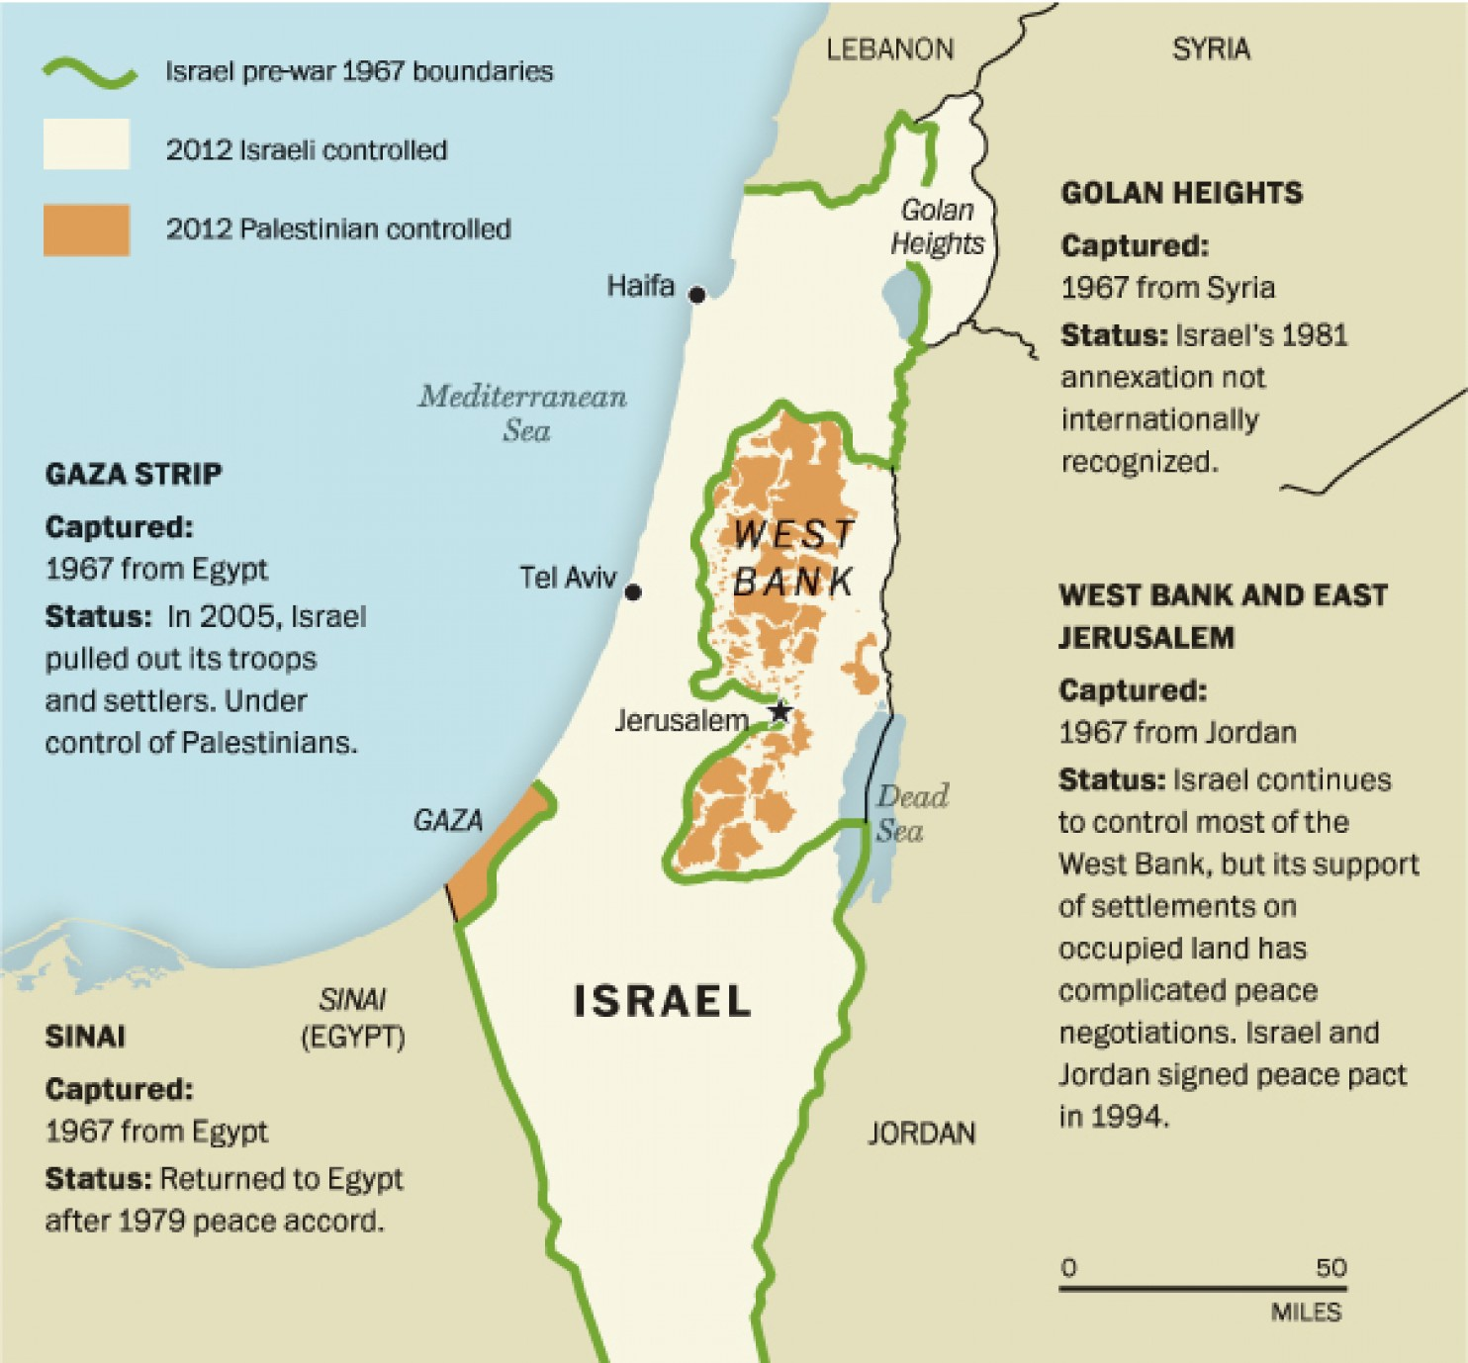

Slide 22
Discuss
What problem(s) does the conflict between the Arabs and Israelis pose to the United States?
Should we be concerned with the situation there? Why or why not?

