Slide 1
Course Introduction: Economics

Slide 2
Nametags
As you come in, grab a seat anywhere and…
Fold your computer paper into thirds
On the middle section, create a nameplate including the following things: your name, a picture that illustrates one of your hobbies, and a random doodle
You’ve only got 5 minutes to get this started, but you can keep adding to it if we have downtime

Slide 3
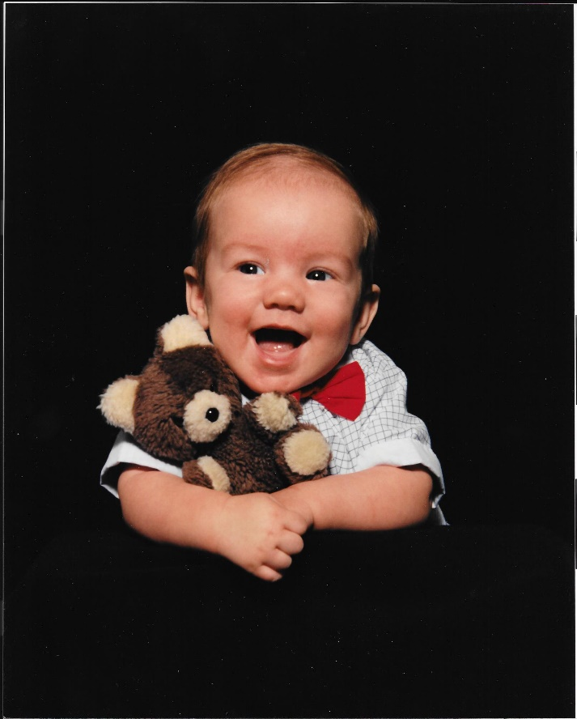
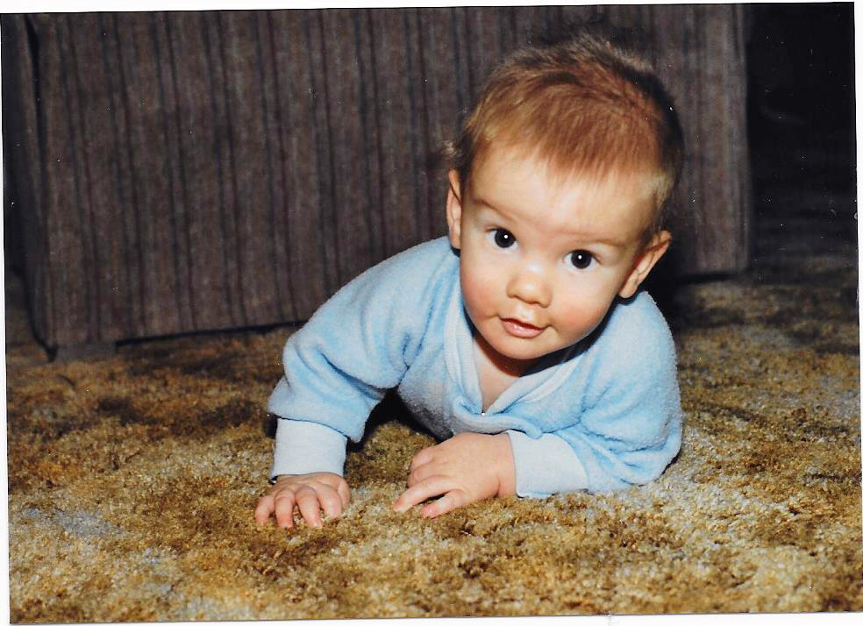
About me: General
Grew up in upstate New York before I moved to Boise
Graduated from BYU, after student teaching at the one and only AFHS
Served a mission in the Czech Republic

Slide 4
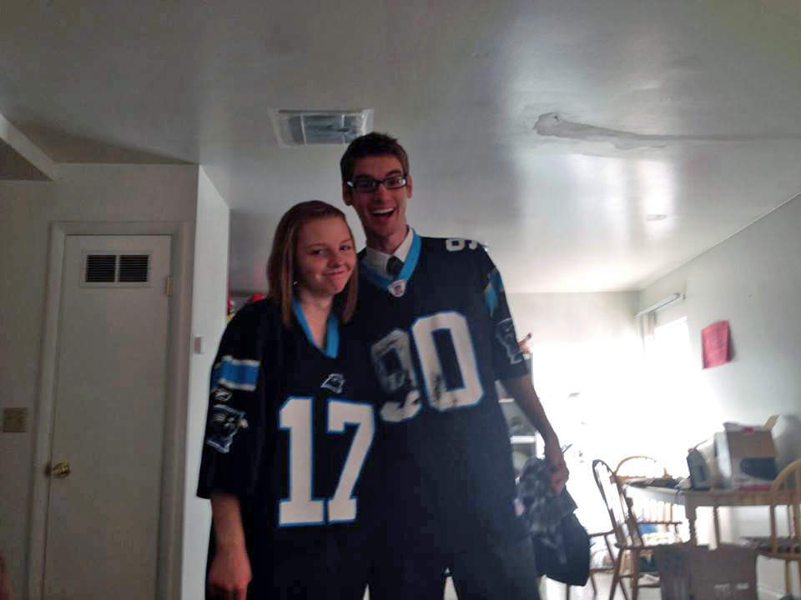
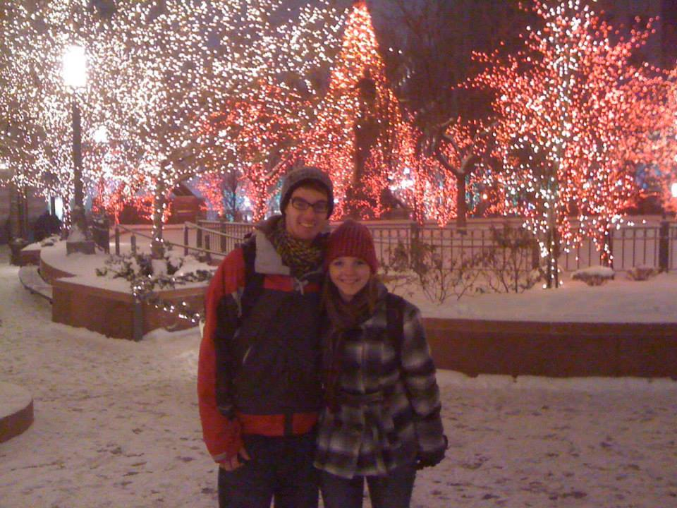
About Me: Family
Married in 2014
No kids yet
1 Nephew= My main man, Oliver

Slide 5
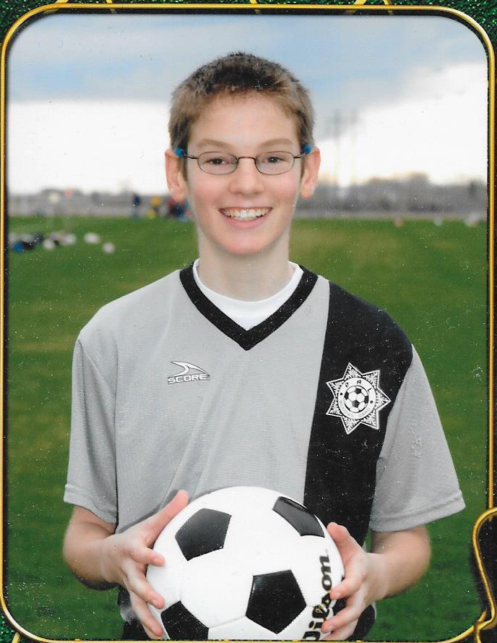
About Me: Hobbies
Computers
Videogames
Creative (Photoshop, Premiere, etc.)
Sports
Soccer
Frisbee

Slide 6
What do you guys want to know?

Slide 7
Seating Chart
Don’t move until I’ve called out all the names.
Pay attention to when I call your name, so you know what seat is yours.
You’ll have 60 seconds to switch to your new seat.
Ready?...

Slide 8
GO!!!!!

Slide 9
Grading
My assignments are designed to help you practice the 4 DOK levels
Daily Quizzes: Every day we’ll start with a quiz that will review content.
These quizzes can’t be made up if you miss them, but I will drop the lowest 5 in each term
Best way to do well is to skim through your notes right before class
In-class Activities: Most days in class, you’ll receive a note sheet that you can use to help take notes. That worksheet will also include activities that we’ll do to practice the historical thinking skills.
I collect these in the form of a binder check at each unit test

Slide 10
Grading (Cont.)
Tests: At the end of each unit we’ll have a unit test, except for the last unit of the term. Then, we will have a term test that goes over everything from the term.
There is not a comprehensive end of year test *pause for thunderous applause*

Slide 11
Class Rules
I have 5 rules:
Follow all school rules.
Allow your teacher to teach.
Allow your classmates to learn.
Be responsible for your own learning.
Accept the consequences of your choices.
And one pet peeve… Phones. Nope

Slide 12
Classroom Tour Stuff
Inbox/Outbox
Phone Box
Tip Jar
Calendar of Super Awesome Stuff
The Website

Slide 13
My First Economics Problem!
A hospital in a town has one dialysis machine that can run for 30 hours per week. As the boss of the hospital, you must decide who gets the treatment:
Patient A: 6-year-old child who needs 10 hours per week. They are awaiting a kidney transplant, which is expected to occur in one year.
Patient B: A 55-year-old man who needs 5 hours per week. He is married with grown up children.
Patient C: A 3-year-old child who will need dialysis indefinitely. Currently needs 4 hours per week.
Patient D: 78-year-old female, 4 hours per week.
Patient E: 7-year-old child with three brothers and sisters, 4 hours per week.
Patient F: 8-year-old child, no brothers and sisters, 5 hours per week.
Patient G: 30-year-old female, two young children, 6 hours per week.
Patient H: 30-year-old male, two young children, 5 hours per week.
Patient I: 30-year-old male, no children, 4 hours per week.
Patient J: 45-year-old man with no children. Needs 6 hours per week but has a brother who will donate a kidney. This will take place in six months’ time.
Patient K: A 65-year-old man who requires 10 hours per week. As he was quite wealthy, he has promised to buy another dialysis machine for the hospital if he is still alive in one year’s time.

Slide 14
How did you decide who got help and who didn’t?

Slide 15
Getting to Know You Kahoot
https://play.kahoot.it/#/?quizId=3df902f6-3fa4-4d9f-8804-ed1c604a252a

