Slide 1
AoC pt. 2 and Constitutional Convention

Slide 2
What Powers did congress have?
In your groups, read the assigned section of the Articles of Confederation. Summarize what powers the federal government had in your section of your organizer
Form a group with one member from each article. Share out what powers each article gives the federal government

Slide 3
Weaknesses of the Articles
No federal taxes
Passing a law needed unanimous consent from the states
No national court system
No national currency
No national army

Slide 4
The Pendulum
ART
Tyranny
Freedom

Slide 5
The Constitutional Convention
May-Sept 1787
Originally meant to revise the AoC
Eventually decided to just start over

Slide 6
Issue #1: Representation
The Question: How many delegates should each state send to Congress?
Small states said it should be the same for everybody
Big states said states with more people should have more representatives
New Jersey Plan
Virginia Plan

Slide 7
Debate!
As a group, come up with reasons why your plan is more fair than the other
Elect one representative to make your case in front of the convention
No compromises (yet)! Just come up with reasons why yours is good and theirs is bad

Slide 8
The Great Compromise
How can we resolve this conflict in a way that is fair to everybody (big and small states)?
Hint: how does the legislative branch look?
Connecticut Plan: have a bicameral legislature where one house is equal representation and the other is based on population
Also known as the Great Compromise
Did this give everybody what they wanted?

Slide 9
And they all lived happily ever…

Slide 10
Issue #2: Who counts as a person
If one of the houses is based on population, who counts?
Northern states: “Slaves are not people, duh.”
Southern states: “Slaves are totally people”
Not a mistake

Slide 11
3/5 Compromise
Eventually they settled on counting slaves as 3/5 of a person
For representation purposes
Not for rights purposes
That was still 0/5 of a person
Bird, mention the slave trade compromise here

Slide 12
Why does everyone want representation so bad?

Slide 13
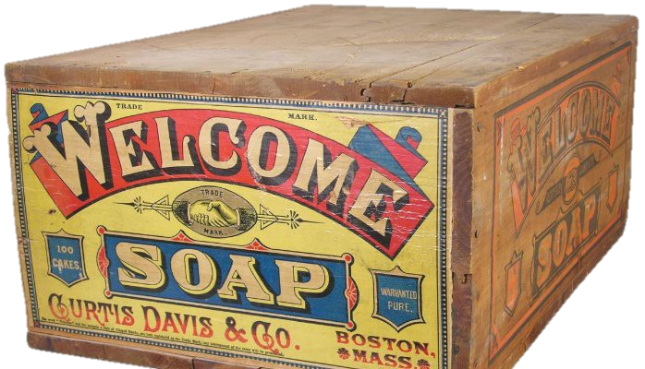

Slide 14
Flashcard Race!
https://www.youtube.com/watch?v=DhlPAj38rHc
Write down your 5 flashcard questions and their answers
Move your butt one seat down the row and read each question and answer for that set. Initial next to each question as you read it
I’ll ask each person a random question from your row. The first row to all answer correctly wins!

Slide 15
For future reference…
Discussion Questions
What do you want to learn in a government class?
What do you need to know to be an informed citizen?
How can I make this required class useful to you?

