Slide 1
Campaign Strategy/ Research Day

Slide 2
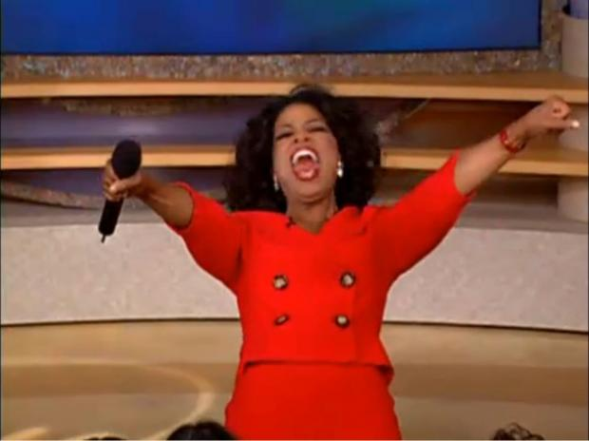
Check in Quiz - 11/21/2019
What are the current requirements to vote in the United States?
Amendments! Give me the number
Redefined who becomes VP
Gave D.C. 3 electoral votes
Allowed women to vote
What is the minimum number of electoral votes a state can have?
EVERYBODY GETS A QUIZ

Slide 3
Review-ish
What states matter to potential presidential candidates?
Swing States: States that have a tendency to vote for either political party
Notable Examples
Colorado, Florida, Iowa, Michigan, Minnesota, Ohio, Nevada, New Hampshire, North Carolina, Pennsylvania, Virginia, and Wisconsin

Slide 4
Primary v. General Election
Different format
Caucus: Members of the party get together to decide on a candidate
Primary elections: Secret ballots where you vote for your preferred nominee
Different strategies

Slide 5
Political Advertising/Media Bias
Intro to our last unit!
Fear Ad: Attack ads against the opposing candidate
Cheer Ad: Ads that focus on why you’re the best candidate
https://www.youtube.com/watch?v=ar96nFBtoQQ
www.livingroomcandidate.com

Slide 6
Research Assignment
Is the electoral college the best way to vote for President in the U.S.? If not, what system should we use and why?
5 paragraph (absolute minimum)
2 sources per paragraph. Include a works cited page.
Won’t accept it under 2 pages, should be more
Due on Monday (Nov 25)

