Slide 1
Battle for Ratification

Slide 2
Pop Quiz!
Yes, it will be graded. Yes, you can retake it
What does the principle of “rule of law” ensure?
List 3 specific weaknesses of the Articles of Confederation
What philosopher did Jefferson “borrow” a lot of his ideas from when he wrote the Declaration of Independence?
What political philosophy states that government should only have the powers it is specifically given (power defaults to the individual)?

Slide 3
Convention Review
Great Compromise:
3/5 Compromise:
Slave Trade Compromise:

Slide 4
What do we need for ratification?
Ratification: the action of signing or giving formal consent to a treaty, contract, or agreement, making it officially valid.
Nine out of thirteen states had to vote to accept the Constitution
We wanted unanimous ratification to build unity between the states

Slide 5
Inspiration for Limited Government
Magna Carta: A list of rights from the year 1215 that King John of England was forced to sign. Meant to protect people’s rights from an oppressive king
English Bill of Rights: A document from 1689 that listed people’s rights and gave power to Parliament over the monarchy

Slide 6
Expressing your opinion with a strongly worded letter
The only classy way to express dissatisfaction with something
As a group, write a letter to the other half of class, explaining why your opinion is right and theirs is wrong
Turns out, the Founding Fathers did a lot of arguing…

Slide 7
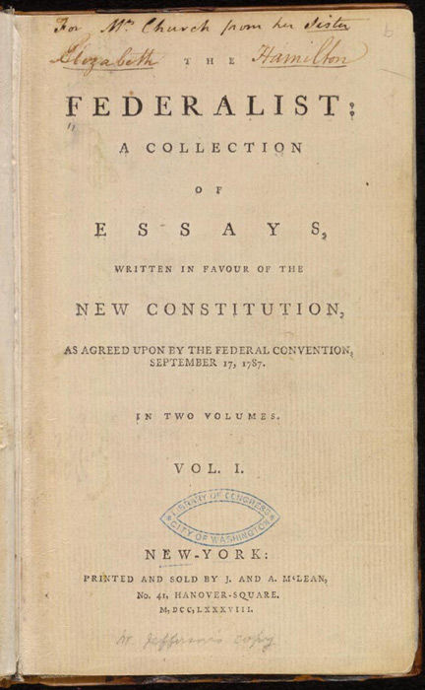
Federalists v. Anti-federalists
Federalists
Group of people who supported the Constitution and strong federal government
Wrote a set of 85 essays explaining their beliefs, under the pseudonym Publius
Included Alexander Hamilton, John Jay, and James Madison

Slide 8
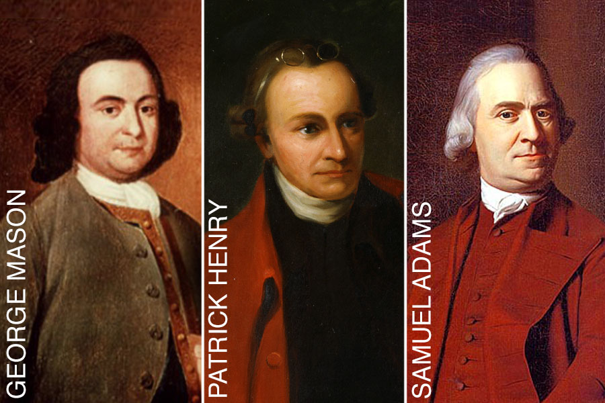
Federalists v. Anti-federalists
Anti-Federalists
Group of people who thought the Constitution gave too much power to the federal government
Wrote essays explaining their beliefs, under many different names
Included lots of different people

Slide 9
What did they want?

Slide 10
Bill of Rights
Can you list them?

