Slide 1
Actually a History Class

Slide 2
A Boring for realsies seating chart

Slide 3
Why Talk about philosophy?
These random dudes were studied by the founding fathers and influenced their ideas
Compare these quotes from Locke’s Second Treatise on Government to Jefferson’s Declaration of Independence
  Pg. 10-14

Slide 4
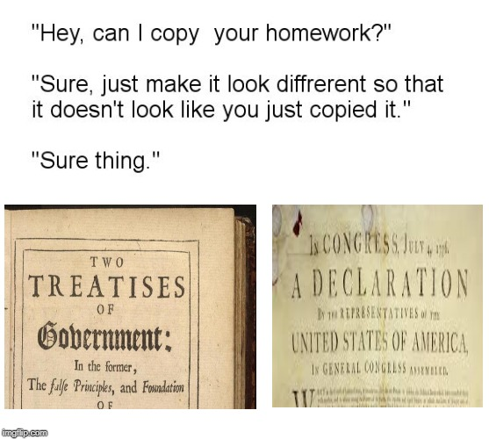
A Spicy Gov Meme

Slide 5
Was the constitution our first government?
Articles of Confederation: the Founding Fathers’ first attempt at writing a governing document
Ultimately failed and had to be rewritten… why?
Take out a piece of paper and fold it in half (hotdog style), then in thirds.

Slide 6
Article III – The Point of it all
“The said states hereby severally enter into a firm league of friendship with each other, for their common defense, the security of their Liberties, and their mutual and general welfare, binding themselves to assist each other, against all force offered to, or attacks made upon them, or any of them, on account of religion, sovereignty, trade, or any other pretense whatever.”
Why did the states write the Articles?

Slide 7
Article II – But…
“Each state retains its sovereignty, freedom and independence, and every Power, Jurisdiction and right, which is not by this confederation expressly delegated to the United States, in Congress assembled.”
What are the possible issues with this article?

Slide 8
What Powers did congress have?
In your groups, read the assigned sections of the Articles of Confederation. Summarize what powers the federal government had in each section in your organizer
Prepare a spokesperson for each article you read (different person for each article)

Slide 9
Weaknesses of the Articles
No federal taxes
Passing a law needed unanimous consent from the states
No national court system
No national currency
No national army

Slide 10
For future reference…
Discussion Questions
  What do you want to learn in a government class?
  What do you need to know to be an informed citizen?
  How can I make this required class useful to you?

