Slide 1
America Moves To War

Slide 2
Daily Quiz – Jan 9/10
#SquadGoals
Students will be able to…
Determine how America shifted from isolationism to internationalism
Determine the effects of the Attack on Pearl Harbor
What was the policy of “appeasement” and where was it decided on?
Describe the German strategy of blitzkrieg

Slide 3
What happened to start WWII?

Slide 4
Timeline
September 18, 1931- Japan invades Manchuria (in China)
March 1938- Germany claims Austria
September 29, 1938- Munich Agreement
September 1, 1939- Germany invades Poland
June 22, 1940- Germany occupies France
December 8, 1941- USA declares war on Japan

Slide 5
How did we get to the last step?

Slide 6
Nye Committee (Review)
It’s job – to find out what got us into WWI
The results – Businesses looking to make money off wartime profits may have pressured the U.S. to go to war

Slide 7
Isolationist Debate
Match the groups on your notes to their definition
Fight for Freedom Committee- Pro-war. Wanted to repeal all the neutrality laws and take stronger action against Germany.
America First Committee- Isolationist group. Opposed Roosevelt’s extra help to the Allied countries
Committee to Defend America by Aiding the Allies- Middle ground. Didn’t want armed conflict, but endorsed supporting the Allies.

Slide 8
What were Roosevelt’s thoughts on war?
Roosevelt was always an internationalist- he thought that international relations would help stimulate the economy
“War is a contagion, whether it be declared or undeclared. It can engulf states and peoples remote from the original scene of hostilities… we cannot have complete protection in a world of disorder in which confidence and security have broken down.”
“…enduring peace cannot be bought at the cost of other people's freedom.”

Slide 9
Jigsaw Activity
In small groups, research the 5 major events leading to America going to war.
Instructions
1. Read through your topic in the text book.
2. Create a poster that includes the topic title, a picture, and relevant information in bullet point format. (Make sure it is big enough to read).
3. Present the information on your topic, while the rest of class takes notes.

Slide 10
Policies moving us toward involvement
Destroyers for Bases: The US gives 50 destroyer class warships to Britain in exchange for the ability to build naval bases on British land
Lend Lease Act: We could lend war materials to countries that were “vital to the defense of the United States”
Hemispheric Defense Zone: Roosevelt says the Western half of the Atlantic Ocean is “neutral” in the war and America will protect it.

Slide 11
Policies moving us toward involvement
The Atlantic Charter: A document made by Roosevelt and Churchill that planned for what the world would look like after the war (democratic)
At this meeting, Roosevelt told Churchill he would look for an excuse to get in the war
Japanese Embargo: In response to Japanese expansion, the U.S. refused to sell war materials to Japan
How does Japan feel about this?

Slide 12
What were the opinions on going to war at this point?

Slide 13
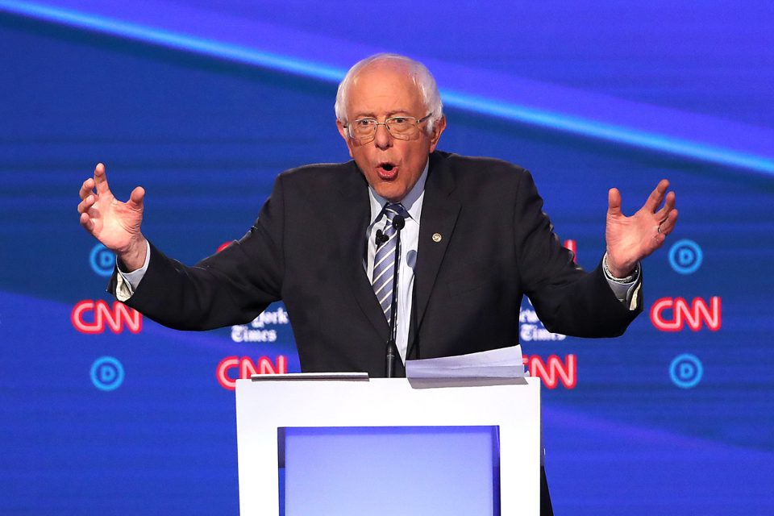
Pearl Harbor
Smooth transition to the other PowerPoint
All things that show up on Google Images when you search “smooth” – even Bernie

Slide 14
“Day of Infamy” Speech
As we listen to Roosevelt ask Congress to declare war on Japan, prepare to answer the following question:
Was declaring war on Japan justified?
https://www.radiochemistry.org/history/video/fdr_infamy.html

Slide 15
Doolittle Raids
https://www.youtube.com/watch?v=-yXzYxUC93A
Plan to bomb Tokyo in retribution for Pearl Harbor
Bombers couldn’t reach Tokyo and make back to an aircraft carrier – not enough fuel
Instead, they would fly over Japan and continue to China, where they could refuel

