Slide 1
https://www.youtube.com/watch?v=tlt6R1KD4E0

Slide 2
A Unit in a day

Slide 3
Weekly Quiz!
What is a civil liberty?
Hint: Civil is the key word
What 5 things are protected in the 1st amendment
Hint: SRAPP
What are civil rights?

Slide 4
Amendment 1
5 basic rights (SRAPP)
Class hand gesture

Slide 5
Amendment 2
Right to bear arms
Class hand gesture

Slide 6
Amendment 3
No Quarter
Class hand gesture

Slide 7
Amendment 4
Search and Seizure
Class hand gesture

Slide 8
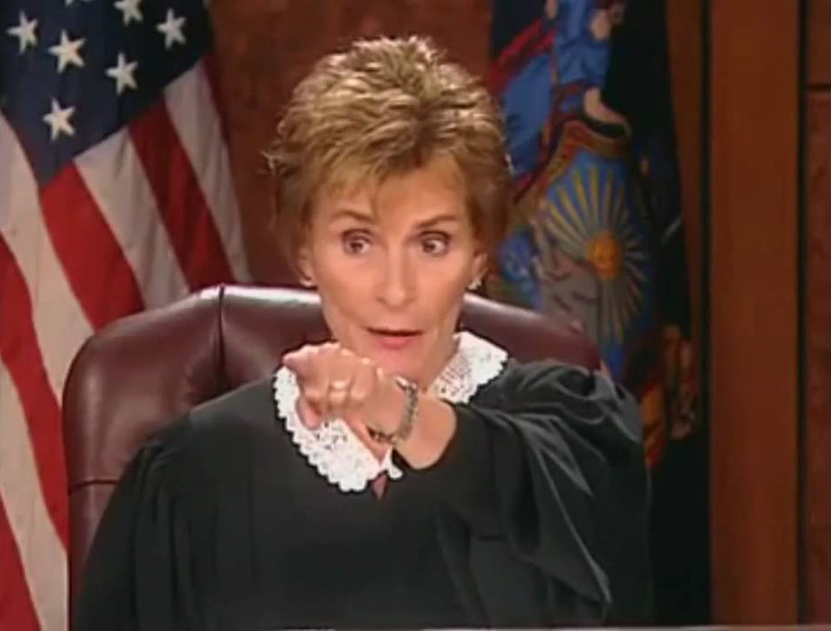
Amendment 5
Due Process
Class hand gesture

Slide 9
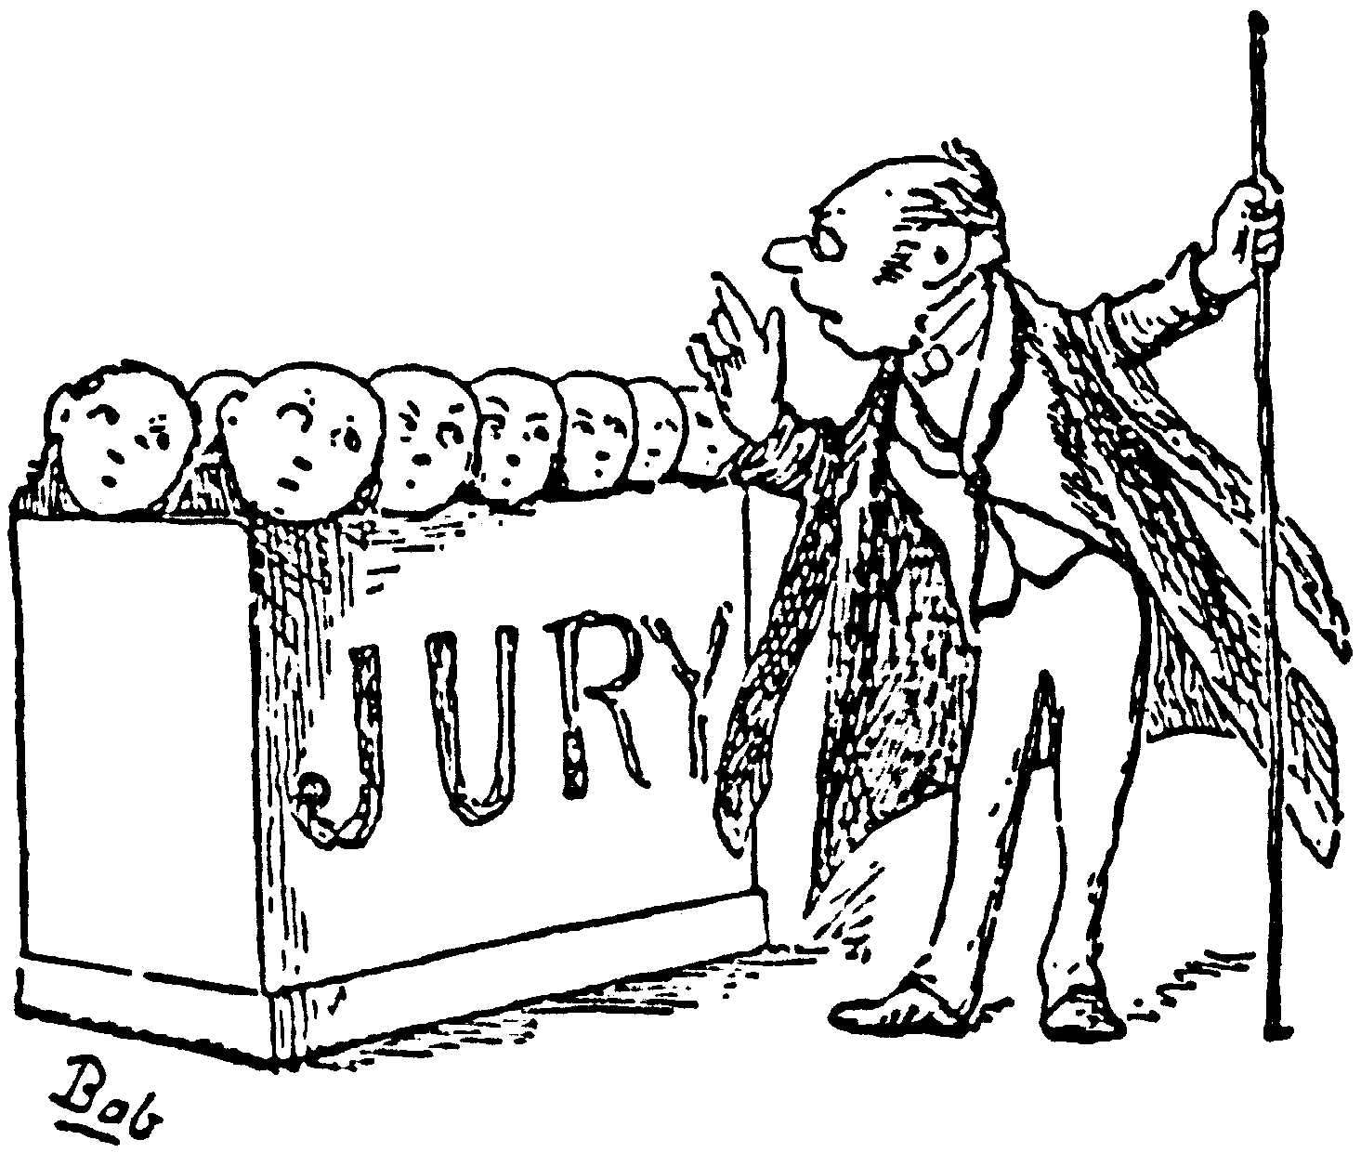
Amendment 6
Rights of the Accused
Class hand gesture

Slide 10
Amendment 7
Rules of civil cases
Class hand gesture

Slide 11
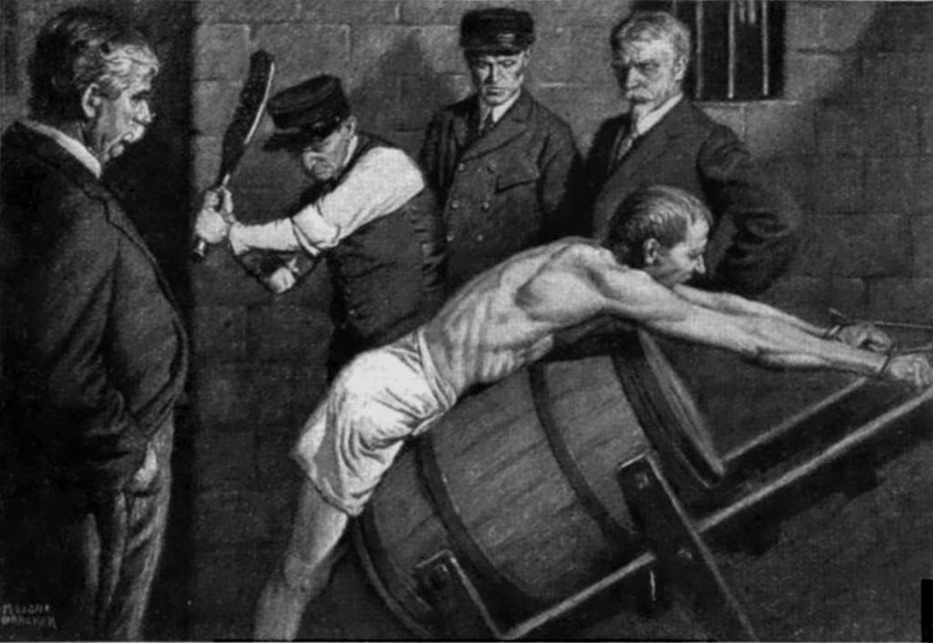
Amendment 8
No cruel or unusual punishment
Class hand gesture

Slide 12
Amendment 9
Other rights, too
Unenumerated Rights: Rights that we have that aren’t listed
Class hand gesture

Slide 13
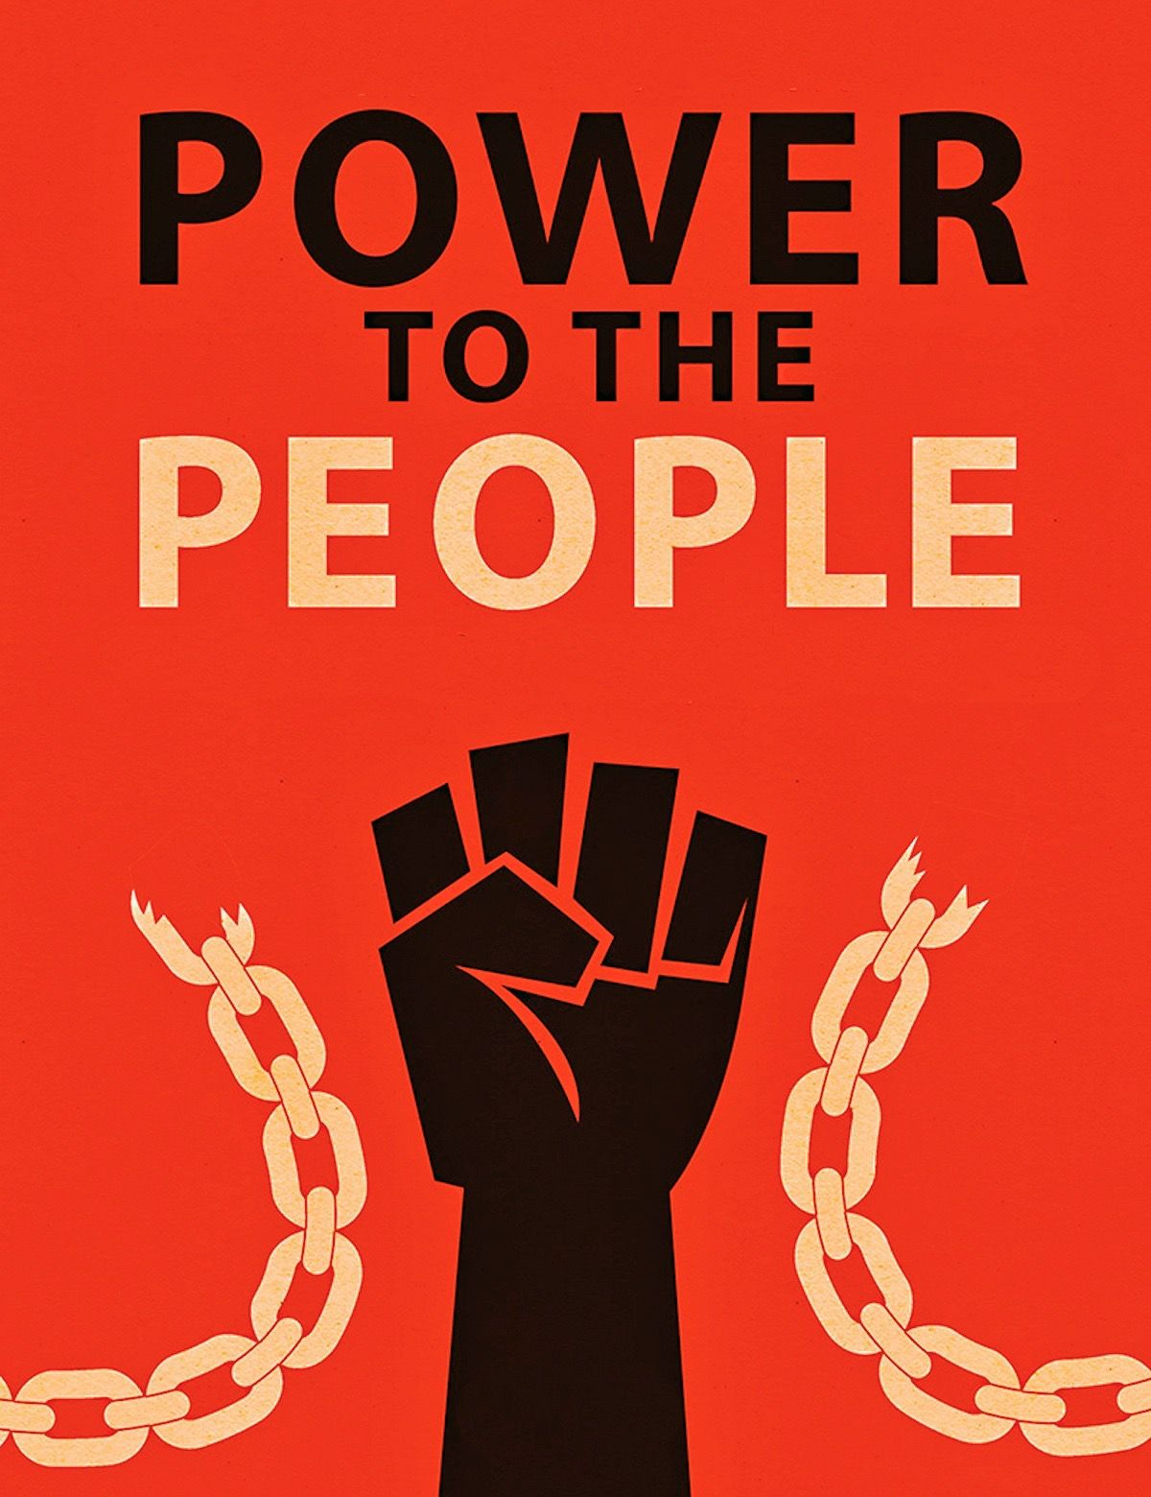
Amendment 10
Power belongs to the People!
Class hand gesture

Slide 14
As you come in…
Review the amendments in the Bill of Rights with a partner. You will be quizzed on them today!
Spoiler Alert: This is the majority of your Unit 3 test, that’s why we’re hitting it so hard.

Slide 15
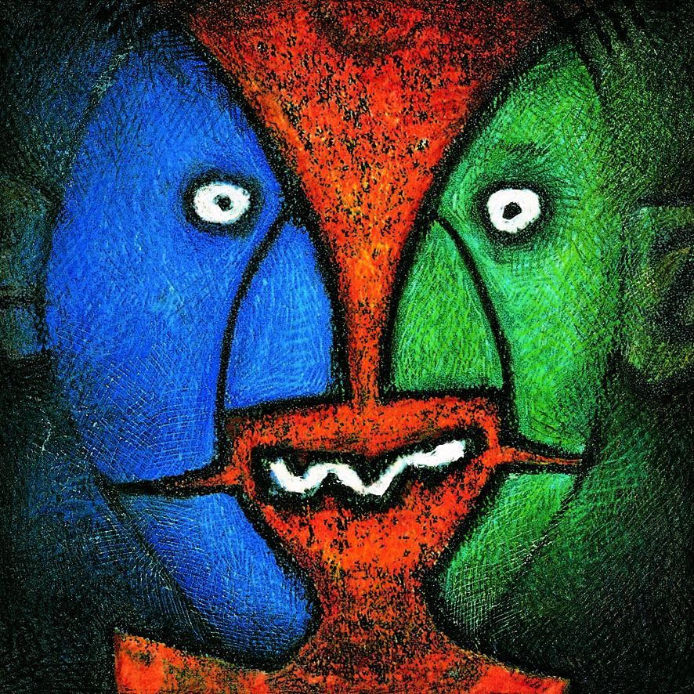
Gesture Duel!
Sit on your desk!
Going around the room, you will compete to be the first one to throw the correct hand gesture for the amendment that I announce. If you win, you keep going; longest streak=champion of the world

Slide 16
Supreme court cases!

Slide 17
Freedom of Expression
Tinker v. Des Moines – Freedom of speech in schools
Protesting Vietnam by wearing arm bands
Texas v. Johnson – Flag burning
New York Times v. US – Freedom of the press over classified documents

Slide 18
Freedom of Religion
Santa Fe Independent School District v Doe – Prayer at public school events

Slide 19
Rights of the Accused
Gideon v. Wainwright – Right to a defense attorney
Miranda v. Arizona – Warn the accused of their rights

Slide 20
Civil Rights

Slide 21
Amendment 13 (1865)
No slavery

Slide 22
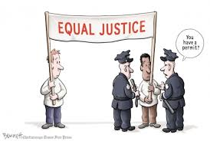
Amendment 14 (1868)
Birthright citizenship
Equal protection under the law

Slide 23
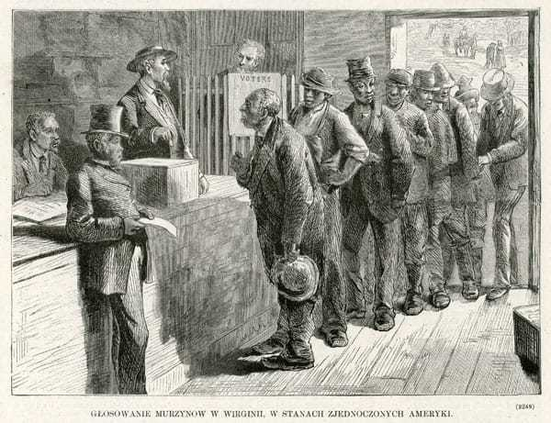
Amendment 15 (1870)
All races can vote

Slide 24
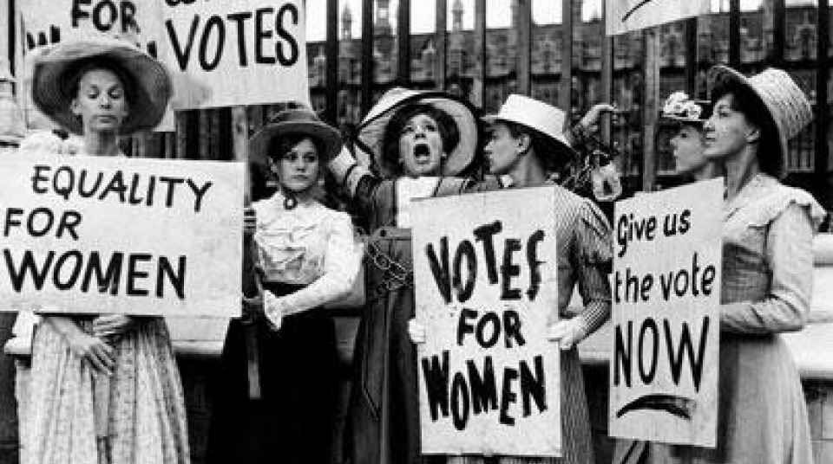
Amendment 19 (1920)
All genders can vote

Slide 25
Laws
Jim Crow Laws: Laws that allowed for segregation throughout the South
Spoiler Alert – This is bad
Civil Rights Act: Stopped discrimination based on race, gender, etc. in public places

Slide 26
Court cases
Roe v. Wade - Abortion
Plessy v. Ferguson – Separate but equal
Spoiler Alert – This is bad
Brown v. Board of Education – Separate isn’t equal
University of California v. Bakke – Affirmative Action
Korematsu v. US – Japanese Internment
Spoiler Alert – This is bad

