Slide 1
A Bloody Conflict

Slide 2
Trench Warfare
Complex dug-out networks
Used to protect troops
Almost all fighting took place in the trenches – most of the fighting sites hardly moved at all throughout the entire war

Slide 5
TRENCH WARFARE CLIP

Slide 6
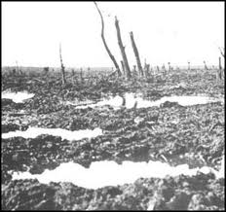
No-man’s-land
The space between opposing trenches
Very Dangerous
In order to prevent troops from crossing, barbed wire was placed in front of trenches

Slide 7
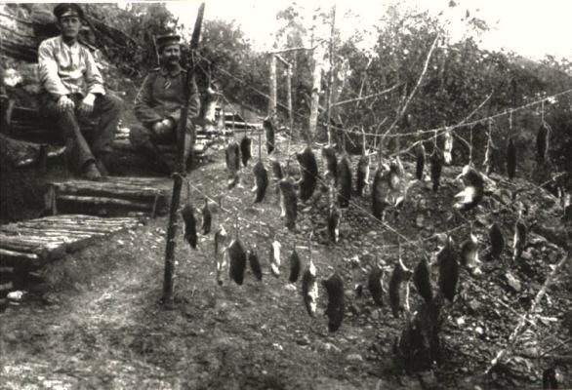
Rats
Ate the corpses
Grew to huge sizes

Slide 8
Robert Graves: "Rats came up from the canal, fed on the plentiful corpses, and multiplied exceedingly. While I stayed here with the Welch, a new officer joined the company and, in token of welcome, was given a dug-out containing a spring-bed. When he turned in that night he heard a scuffling, shone his torch on the bed, and found two rats on his blanket tussling for the possession of a severed hand."

Slide 9
Lice
97% of men had lice because there were hardly any sanitary conditions
Spread throughout entire units
Lice carried diseases such as Trench Fever
Military tried to combat it with de-lousing techniques

Slide 10
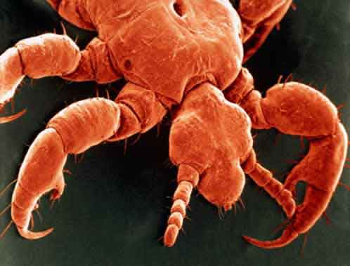

Slide 11
One night, as we lay in bed after doing our two hours' sentry - we did two hours on and two hours off - my friend Jock said 'damn this, I cannot stand it any longer!' He took off his tunic - we slept in these - then he took off his jersey, then his shirt. He put his shirt in the middle of the dug-out floor and put his jersey and tunic on again. As we sat up in bed watching the shirt he had taken off and put it on the floor it actually lifted; it was swarming with lice.
Interview
Henry Gregory

Slide 12
Trenchfoot
Men would stand for hours in water logged trenches
They couldn’t remove wet socks or boots, feet would often go numb
If untreated it results in amputation
The military began requiring regular changing of socks and boots, as well as the use of whale oil to protect feet from getting wet

Slide 13
The trench, when we reached it, was half full of mud and water. We set to work to try and drain it. Our efforts were hampered by the fact that the French, who had first occupied it, had buried their dead in the bottom and sides. Every stroke of the pick encountered a body. The smell was awful.
Memoirs
Private Pollard

Slide 14
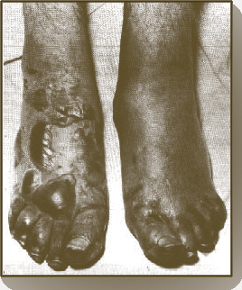

Slide 15
If you have never had trench feet described to you. I will tell you. Your feet swell to two or three times their normal size and go completely dead. You could stick a bayonet into them and not feel a thing. If you are fortunate enough not to lose your feet and the swelling begins to go down. It is then that the intolerable, indescribable agony begins. I have heard men cry and even scream with the pain and many had to have their feet and legs amputated.
Post War Interview
Sergeant Harry Roberts

Slide 17
Shellshock
Symptoms include tiredness, irritability, giddiness, lack of concentration and headaches, ranging from moderate panic attacks to effective mental and physical paralysis
80,000 cases in the
British army alone
Sounds like PTSD

Slide 18
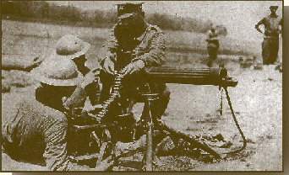
New Technology
This was a whole new war with technology
Machine gun is invented
  With a rifle ten rounds per minute could be fired
  A Machine gun could fire ten rounds per second
  Responsible for most casualties during the war

Slide 19
Poison Gas
First used by the Germans in 1915
Mustard gas and chlorine gas
Fumes cause vomiting, blindness, and suffocation
Gas mask was developed

Slide 20
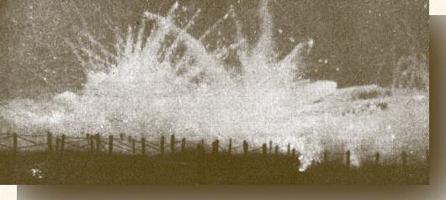

Slide 21
I wish those people who write so glibly about this being a holy war, and the orators who talk so much about going on no matter how long the war lasts and what it may mean, could see a case - to say nothing of 10 cases of mustard gas in its early stages - could see the poor things all burnt and blistered all over with great suppurating blisters, with blind eyes - sometimes temporally, some times permanently - all sticky and stuck together, and always fighting for breath, their voices a whisper, saying their throats are closing and they know they are going to choke.
Field Nurse 1918
Vera Brittain

Slide 22
Armored Tank
Introduced by the British
Slow and mechanically unreliable
It could cross barb wire and trenches, but the technology was still not good enough

Slide 23
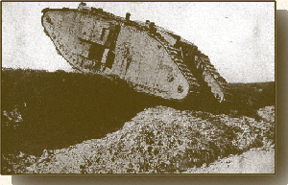
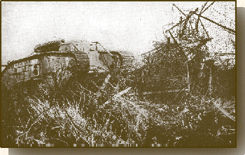

Slide 24
The First Tanks in Action, September 15,1916
We heard strange throbbing noises, and lumbering slowly towards us came three huge mechanical monsters such as we had never seen before. My first impression was that they looked ready to topple on their noses…Instead of going on to the German lines the three tanks assigned to us straddled our front line, stopped and then opened up a murderous machine-gun fire, enfilading us left and right. There they sat, squat monstrous things, noses stuck up in the air, crushing the sides of our trench out of shape with their machine-guns swiveling around and firing like mad.
- Bert Chaney

Slide 25
Zeppelins
Developed by Germans
Giant, rigid balloons
Used to drop bombs on British warships

Slide 26
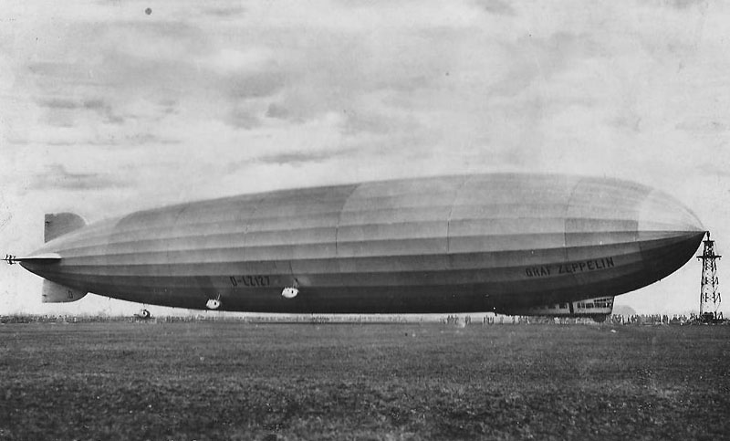

Slide 27
Airplanes
At first used for scouting
Then used to attack Zeppelins
Once machine guns were put in, they were used to shoot down other aircraft
DOG-FIGHTS : two planes fighting each other
Planes were difficult to fly and easy to attack
Airplanes/Pilots lasted about two weeks

Slide 28
Bring it all together
What do you think is the worst condition of trench warfare?

Slide 29
The Americans Arrive
2 million troops
Boosted the allies
Demoralized the Germans

Slide 30
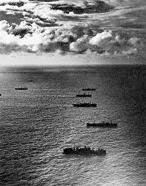
Winning the war at Sea
Convoys: Merchant ships with troop transports
Destroyers would protect and escort the convoys across the Atlantic

Slide 31

Russia Leaves the War
Riots break out in Russia over the scarcity of food and oil
Russia is dealing with a Revolution in their country
Government is overthrown, communists take over, Russia pulls out of World War I

Slide 32
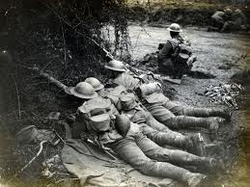
Germany’s Last Offensive
Last massive attack by Germany to try and take Paris
March 1918
Warfare used was poison gas and huge artillery bombardment
American and French troops blocked offensive and held ground

Slide 33
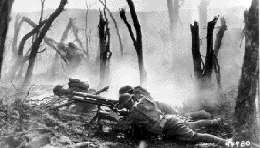
The Battle of the Argonne Forest
Counterattack by the Allies
Most massive attack in American History
Over 600,000 American troops
Germans slowly fell back between September to November

Slide 34
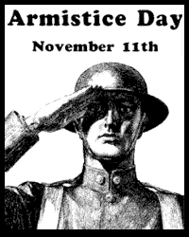
Armistice
An agreement to stop fighting
The armistice took place November 1918 on the 11th hour, the 11th day, of the 11th month

