Slide 1
8-4 Vietnam Day 2

Slide 2
Gallery Walk! (Step One)
OBJECTIVE
Students will be able to…
Describe the events leading to the conclusion of Vietnam
Determine whether the United States’ actions during the war were justified
AGENDA
Story Time!
Anti War Propaganda
Vietnamization
Meet with the other students that wrote an inscription for your picture
Discuss the picture and why you wrote what you did
Choose your favorite inscription and beautifully “etch” it onto a plaque and tape it under your picture

Slide 3
Gallery Walk! (Step Two)
OBJECTIVE
Students will be able to…
Describe the events leading to the conclusion of Vietnam
Determine whether the United States’ actions during the war were justified
AGENDA
Story Time!
Anti War Propaganda
Vietnamization
Roam the gallery (museum rules) and read the different inscriptions. Answer the questions on your note sheet for each of the different pictures

Slide 4
Review
French Colonization
Gulf of Tonkin
Vietnamese Conflict
Tet Offensive

Slide 5
Story Time!!!

Slide 6
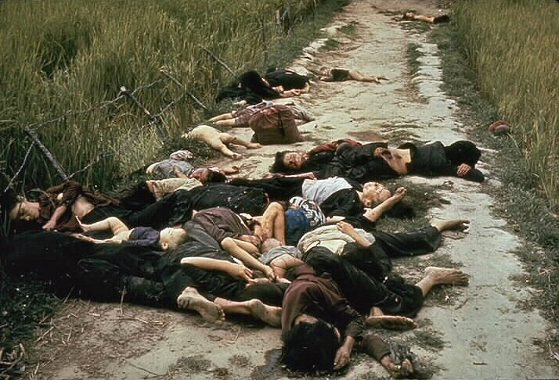

Slide 7
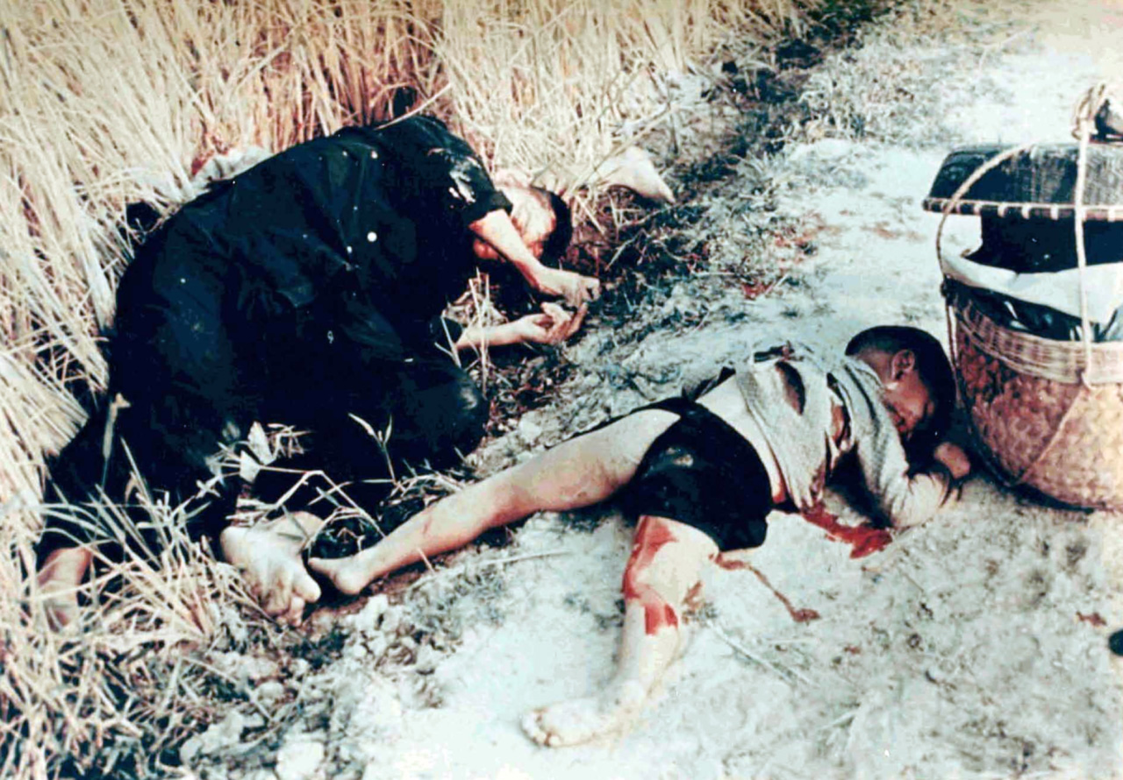

Slide 8
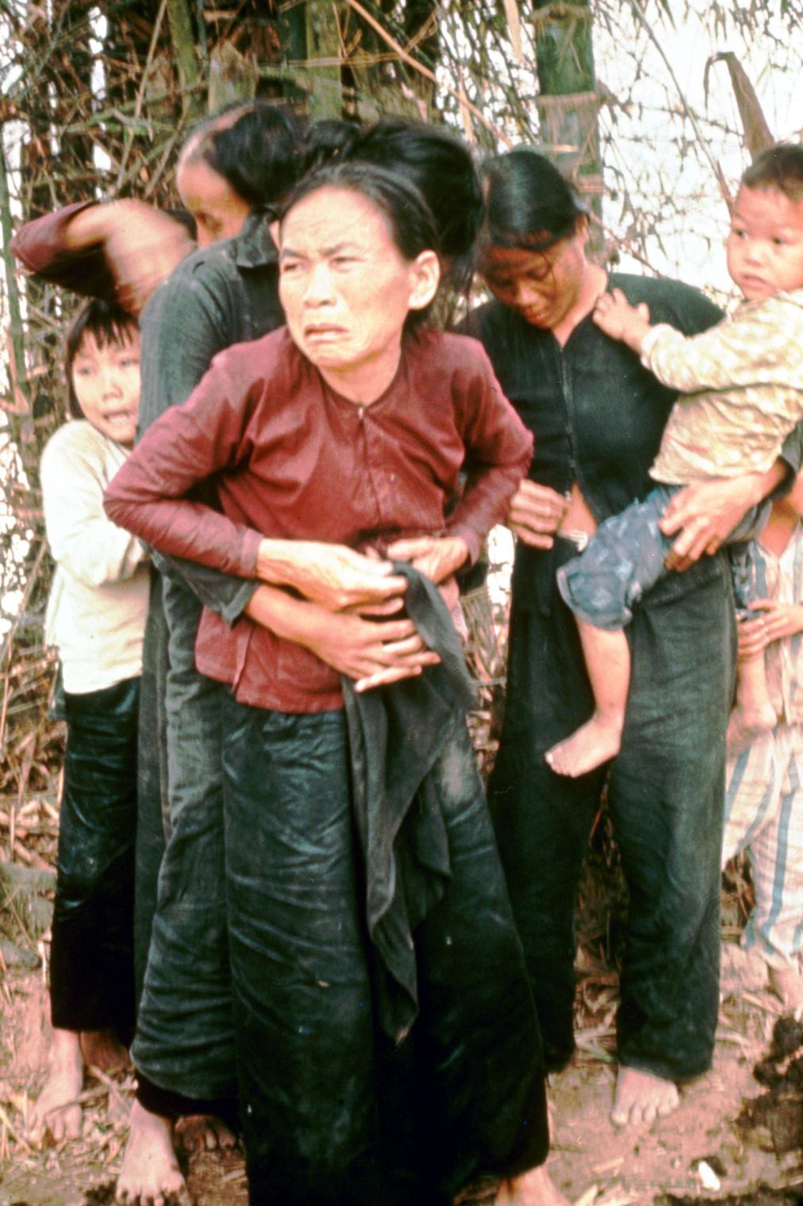

Slide 9
My Lai Massacre
Take a few minutes to silently respond to the story. Make sure to answer the following questions…
What sort of emotions did you feel as Mr. Bird read the story?
Was the United States justified in all its actions during Vietnam?
How do you think American citizens responded to hearing about this story?

Slide 10
Anti-War Sentiments
A lack of results and unflattering media coverage helped create a cultural backlash against the war in America
The anti-war movement was contemporary with other movements for social change, including the civil rights movement, counterculture, etc.
Most protests were peaceful, but occasionally turned violent

Slide 11
War, huh yeah What is it good for? Absolutely nothing, oh hoh, oh War huh yeah What is it good for? Absolutely nothing, say it again y'all War, huh good God What is it good for? Absolutely nothing, listen to me
Oh, war, I despise 'Cause it means destruction of innocent lives War means tears to thousands of mothers eyes When their sons go off to fight and lose their lives
Oh war, is an enemy to all mankind The thought of war blows my mind War has caused unrest within the younger generation Induction, then destruction who wants to die
Oh, war has shattered many young man's dreams Made him disabled bitter and mean Life is much too short and precious to spend fighting wars these days War can't give life it can only take it away, ooh
Peace love and understanding tell me Is there no place for them today They say we must fight to keep our freedom But Lord knows there's got to be a better way

Slide 12
"Hey, Vietnam, Vietnam, Vietnam, Vietnam, Vietnam,
Yesterday, I got a letter from my friend fighting in Vietnam And this is what he had to say, 'tell all my friends that I'll Be coming home soon, my time'll be up some time in June Don't forget", he said, "to tell my sweet Mary her golden lips Are sweet as cherry", and it came from Vietnam, Vietnam...
It was just the next day, his mother got a telegram It was addressed from Vietnam, now mistress Brown She lives in the USA and this is what she wrote and said "Don't be alarmed", she told me the telegram said "But mistress Brown your son is dead" And it came from Vietnam, Vietnam, Vietnam, Vietnam...
Somebody please stop that war now, Vietnam, Vietnam I wanna say now somebody stop that war"

Slide 13
Kent State Protests
President Nixon announces that we’re invading Cambodia to hunt Viet Cong. Americans think this means we’re expanding the war and protest.
Watch the video and answer the questions about the Kent State shootings
https://www.youtube.com/watch?v=9Pwro3vCUdU
What effect did the Vietnam War and events like Kent State have on Americans’ trust in government?

Slide 14
Vietnamization
President Nixon’s “Silent Majority” speech announced a new strategy for the war in Vietnam
November 3rd, 1969
Vietnamization- We were going to turn the war over to the Vietnamese. We would train the South Vietnamese and then slowly pull our own troops out.

Slide 15
End of the War
In 1973, the United States signs the Paris accords, bringing our troops home
Peace with Honor- We told ourselves that we had done everything we could to prepare South Vietnam and us leaving was the “honorable” choice.
Within two years, North Vietnam captures the South Vietnam capital, Saigon, creating a single, Communist country

