Slide 1
Vietnam Day 1

Slide 2
Writing Quiz
OBJECTIVES
Students will be able to…
Relate the events leading up to open conflict in the Vietnam War
Determine whether the United States was justified in its course of action during the war
AGENDA
Journal
Vietnamese Independence
Gulf of Tonkin
Story Time!!!
Listen to the song (Creedence Clearwater Revival’s “Fortunate Son”) playing as you come in. Describe the message of the song, using examples from the lyrics. What does the song say about American culture during the Vietnam War?

Slide 3
Lyrics
Some folks are born made to wave the flag Ooh, they're red, white and blue And when the band plays "Hail to the chief" Ooh, they point the cannon at you, Lord It ain't me, it ain't me, I ain't no senator's son, son It ain't me, it ain't me; I ain't no fortunate one, no Some folks are born silver spoon in hand Lord, don't they help themselves, oh But when the taxman comes to the door Lord, the house looks like a rummage sale, yes
It ain't me, it ain't me, I ain't no millionaire's son, no It ain't me, it ain't me; I ain't no fortunate one, no
Some folks inherit star spangled eyes Ooh, they send you down to war, Lord And when you ask them, "How much should we give?" Ooh, they only answer More! more! more! yoh
It ain't me, it ain't me, I ain't no military son, son It ain't me, it ain't me; I ain't no fortunate one, one
It ain't me, it ain't me, I ain't no fortunate one, no no no It ain't me, it ain't me, I ain't no fortunate son, no no no

Slide 4
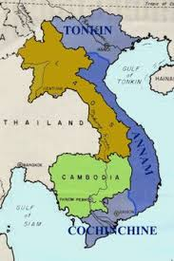
French Colonization
Where is modern day Vietnam?
France takes control of Vietnam from China in 1885
Calls it French Indochina
Japan captures French Indochina during WWII
Ho Chi Minh fights for Vietnamese independence after WWII

Slide 5
Document Analysis!

Slide 6
French Colonization (Results)
France gives Minh control of North Vietnam in 1954
The US supports democratic South Vietnam
Domino Theory- US theory that says if one country in a region falls to Communism, the rest will follow.

Slide 7
Gulf of Tonkin
The United States sends ships into the Gulf of Tonkin to intercept North Vietnamese communications
August 2, 1964 – Naval “skirmish” between U.S. and N. Vietnam
President Lyndon B. Johnson asks Congress to pass a resolution, letting him do whatever it takes to “[support] freedom and [protect] peace in southeast Asia.”
August 7, 1964 – The Gulf of Tonkin Resolution is passed

Slide 8
Document Analysis!

Slide 10
Vietnamese Conflict
What about the Vietnamese environment would make it difficult to fight?
Napalm: Back and bigger than ever
Viet Cong – South Vietnamese that fought against the United States and the South Vietnam government
Had regular combat troops, as well as guerilla forces
How effective would guerilla warfare in that type of environment be?
In response, the United States started a massive bombing campaign that stretched into neighboring countries

Slide 13
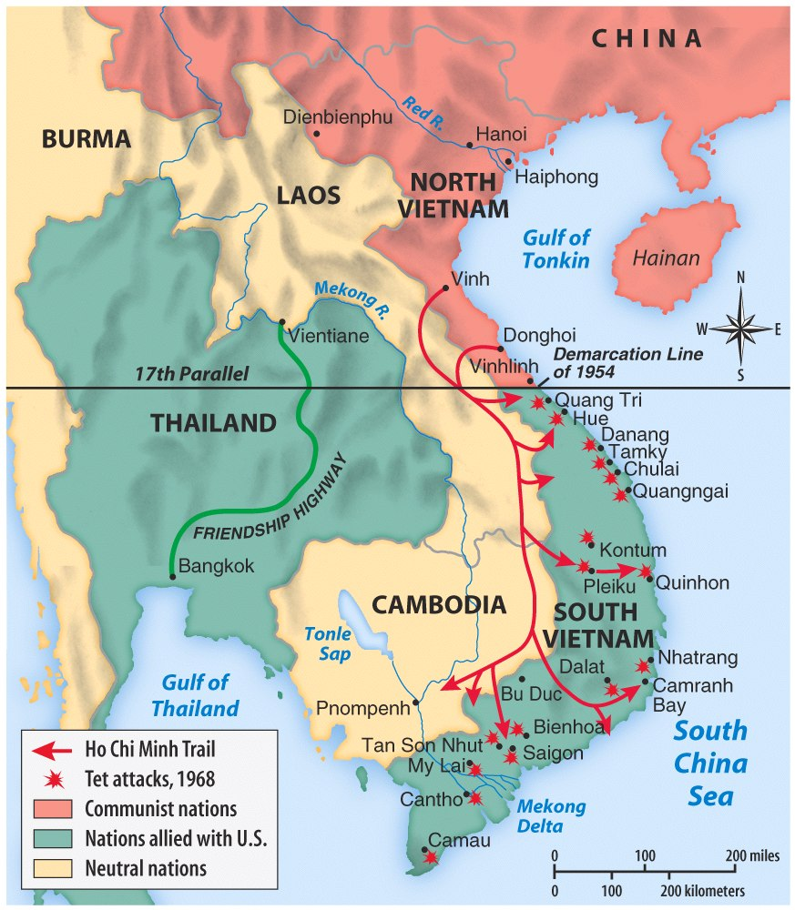
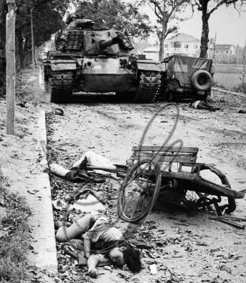
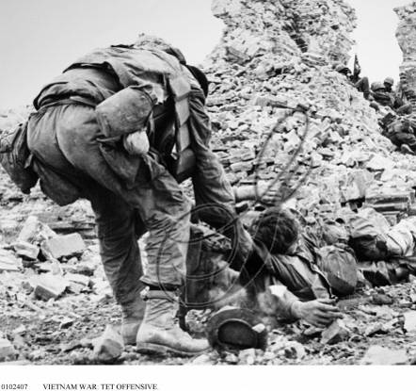
The Tet Offensive, 1968
In early 1968, the Vietcong launched the Tet Offensive against U.S. forces in South Vietnam
The attack was contrary to media reports that the U.S. was winning the Vietnam War

Slide 14
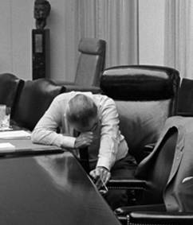
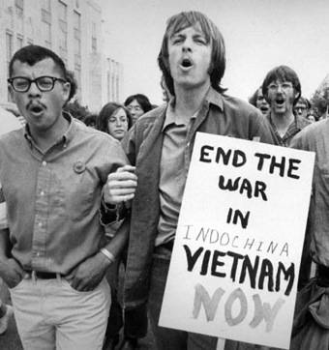
The Tet Offensive, 1968
The Tet Offensive was a turning point in the Vietnam War
American attitudes towards the war changed & anti-war movement grew
President Johnson began to question whether the war could be won…
…& LBJ announced that he would not seek re-election
“Johnson’s War”

Slide 15
Homework!
You have just been promoted to museum curator. Congratulations!
You are responsible for designing an exhibit showing off photographs taken during the Vietnam War. You will write a (3 sentence max) description of the picture that clearly describes the contents of the picture, as well as how it relates to other events/feelings going on during the war.
On your note sheet, check the box next to the picture you are assigned so that you don’t forget which one is yours!

