Slide 1
8-1 Korean War pt. 1

Slide 2
Opening Activity
Today we’ll be talking about a war called “The Forgotten War.” Make a list of everything you know about the war in Korea.
Then come up with two questions you have about the war

Slide 3
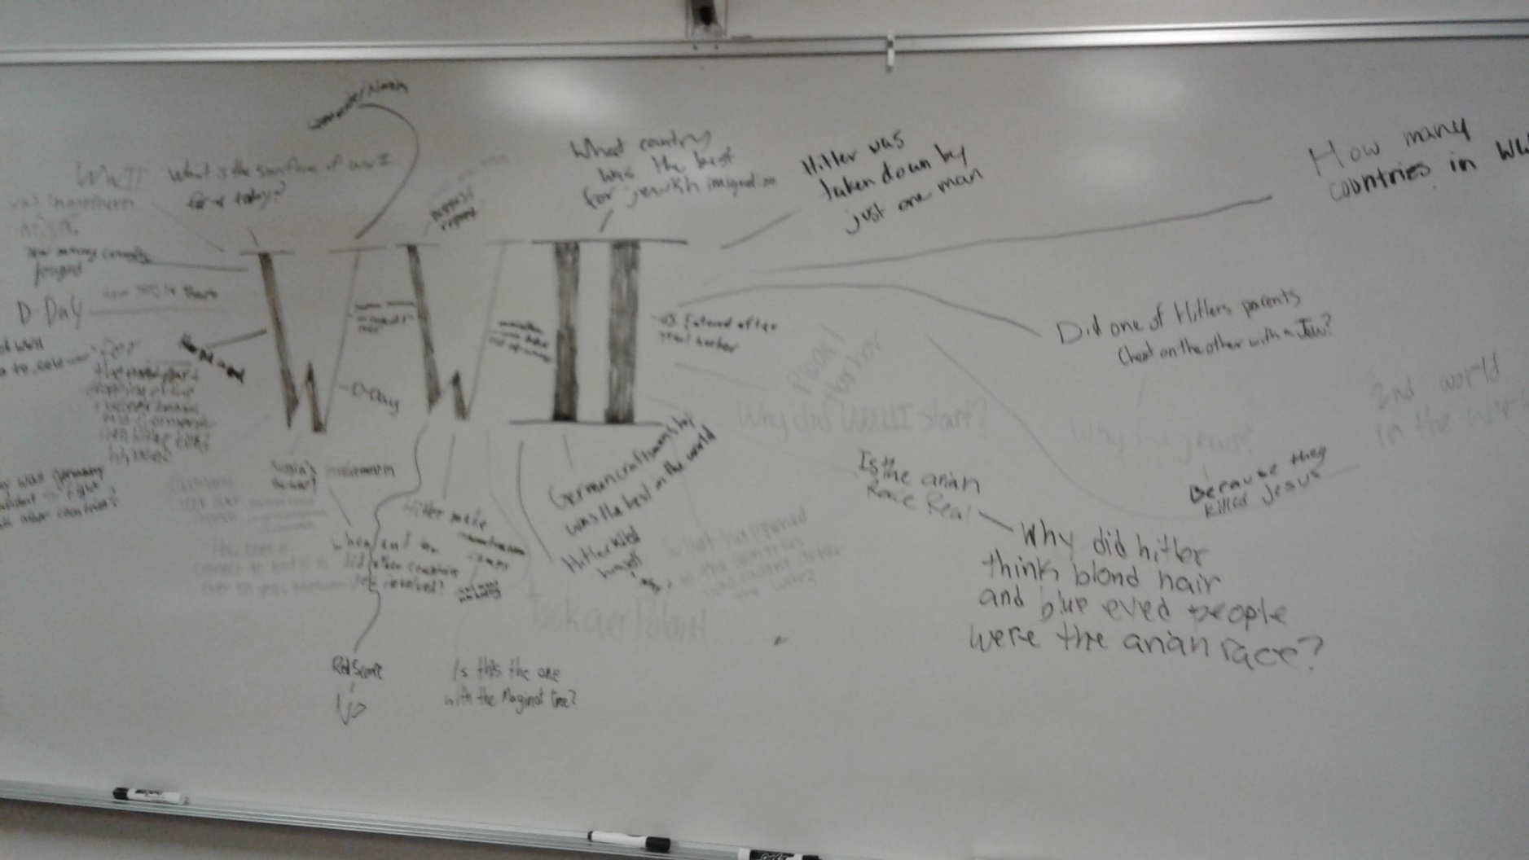

Slide 4
Announcements
End of term stuff
Collect essays

Slide 5
Review
Japan in WWII
Containment
Truman Doctrine
How the UN Security Council works

Slide 6
Brief History of China
Starting in the 1930s, the Communist Party in China revolted against the ruling Nationalist Party
Communist Party led by Mao Zedong
Nationalists led by Chiang Kai-shek
During WWII, there was an unstable truce

Slide 7
Brief History of China
After WWII, the United States supported the Nationalists, but it wasn’t enough
October 1, 1949 – Mao Zedong declares China the “People’s Republic”
Communist China and the USSR form an alliance
The U.S. uses its veto power to keep Communist China from being recognized in the U.N.

Slide 8
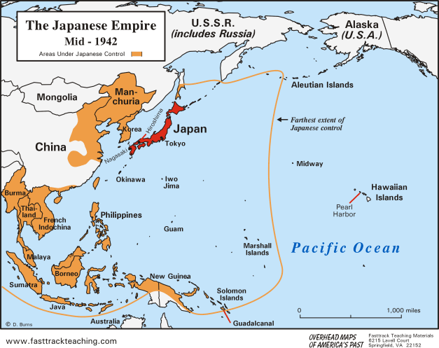

Slide 9
A Tale of Two Countries
Read the sections of the textbook on the Korean War on pages 327-329
Answer the questions on your note sheet

Slide 10
Breakout
What are some issues with learning history from a textbook?
We have two textbooks describing the start of the Korean War
Individually, read both excerpts and answer the questions on your worksheet
In a group of 2, discuss your answers to the questions
After discussing, return to the first question of the slide and write a short response (3+ sentences) using examples from this activity. You only need one write up per partnership

Slide 11
A Tale of Two Countries
After WWII, the Allies freed Korea from Japanese control
Then we promptly Germany-ed it
The US prompted South Korea to create its own government
The USSR was not impressed and told its supporters to boycott elections
The USSR established a communist government in North Korea under Kim Il-Sung

Slide 12
A Tale of Two Countries
North Korea invades South Korea, Truman feels threatened
The U.S. asks the U.N. for help
What happens?
The USSR is boycotting the U.N. for keeping China out, so the U.S. is successful in getting the support of the U.N.
Truman orders troops to Korea

Slide 13
Homework: Storyboarding!
On the back of your note sheet create a storyboard describing the events that lead up to the Korean War
A storyboard is the template movie makers use as they sketch out their plans
Basically, it’s like a short comic strip

Slide 14
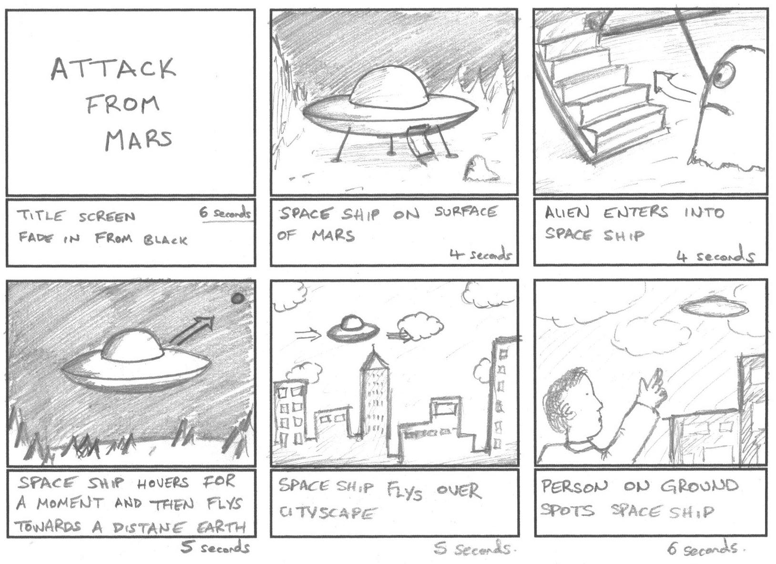

Slide 15
Four Corners
I’m going to ask a series of questions about the start of the Korean War. You’ll answer by moving to a designated corner of the room.
Top-right: Podium
Top-left: Red Chair
Bottom-left: Door
Bottom-right: Desks

Slide 16
Who was responsible for starting the Korean War?
South Korea
United States
North Korea
The USSR

Slide 17
Was the United States justified in establishing a government in South Korea?
Yes!
No!

Slide 18
Was the United States justified in sending troops to Korea?
Yes!
No!

Slide 19
Exit Slip
How did WWII change the United States’ role in foreign affairs, and how is that demonstrated in the start of the Korean War?

