Slide 1
60’s Counter Culture

Slide 2
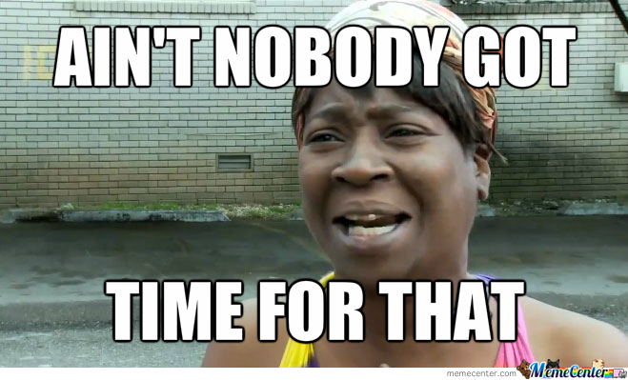
Daily Quiz

Slide 3
Debrief Last Classes
Why was America involved in Vietnam? (What was our purpose there)
How did we get involved? (What events)
Describe the fighting in Vietnam and what made it difficult for Americans
How did Americans feel about the war? Why

Slide 4
Debrief Last Classes
How were the movie clips?
  What stood out to you from the clips?
How accurately did they show the fighting in Vietnam?
  What biases did you notice?

Slide 5
Kent State Massacre
In response to Nixon expanding the war, protests broke out across the country, especially among the youth
Read the article describing the events that happened at Kent State and answer the questions on your note sheet from last class.

Slide 6
Hippies Counter-Culture
Based off the word alone, what does “counterculture” mean?
  A rebellious movement that was trying to reject the traditional culture
acid: LSD;
bread: money;
blow your mind: to shock or delight;
freak: beyond the norm, good or bad;
go down: to occur;
head: a person who turns on through the use of "pot" or "acid";
heavy: serious;
horseman: Mountie;
The Man: policeman;
narc: narcotics agent;
strung out: mentally and physically exhausted;
turn on: to get high on drugs;
wasted: highly relaxed euphoria.

Slide 7
Hippie CounterCulture
Different “types” of hippies
  - the communalist, who preaches togetherness and co-operation and often sets up communes;
  - the religionist, who strives to expand the mind and is often committed to Eastern religions such as Buddhism;
  - the hedonist, who advocates free love;
  - the protestor, who is more concerned with political goals.
Some of the older hippies resented younger or “tourist” hippies

Slide 8
Hippie Counterculture
Lots of different hippie communities
  Haight-Ashbury, San Francisco

Slide 9
Video Links
http://www.cbc.ca/archives/entry/hippie-life-it-aint-easy
http://www.cbc.ca/archives/entry/welcome-to-the-future-less-work-more-play

Slide 10
Homework
Protest Songs
  Blowing in the Wind: https://www.youtube.com/watch?v=3l4nVByCL44
  Turn, Turn, Turn: https://www.youtube.com/watch?v=W4ga_M5Zdn4
  Fortunate Son: https://www.youtube.com/watch?v=ec0XKhAHR5I
Woodstock: https://www.youtube.com/watch?v=StFhvAIv3Js

