Slide 1
50’s Culture

Slide 2
Returning Home
G.I. Bill:
Passed June 24, 1944
Gave job priority to veterans, 52 weeks of unemployment benefits, monthly allowances, and low interest loans.
Why would the government pass this?
Want to ease soldiers back into civilian life
Allows soldiers to buy homes leading to massive suburbanization

Slide 3
Baby Boom
Fertility rate ( # of births per 1,000 women) peaked at 123 in 1957. An American baby was born every 7 seconds.
Why?
More men in society returning after WWII.
GI bill allows men to start a family. Married at a younger age then their parents
Medical science improved - increasing the survival rate of babies.
Good economy ( no fear of loosing a job and not being able to support the family)

Slide 4
What effect would the G.I. Bill and the baby boom have on American culture as a whole?

Slide 5
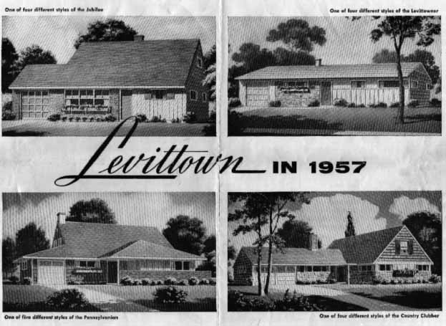
Conformity

Slide 6
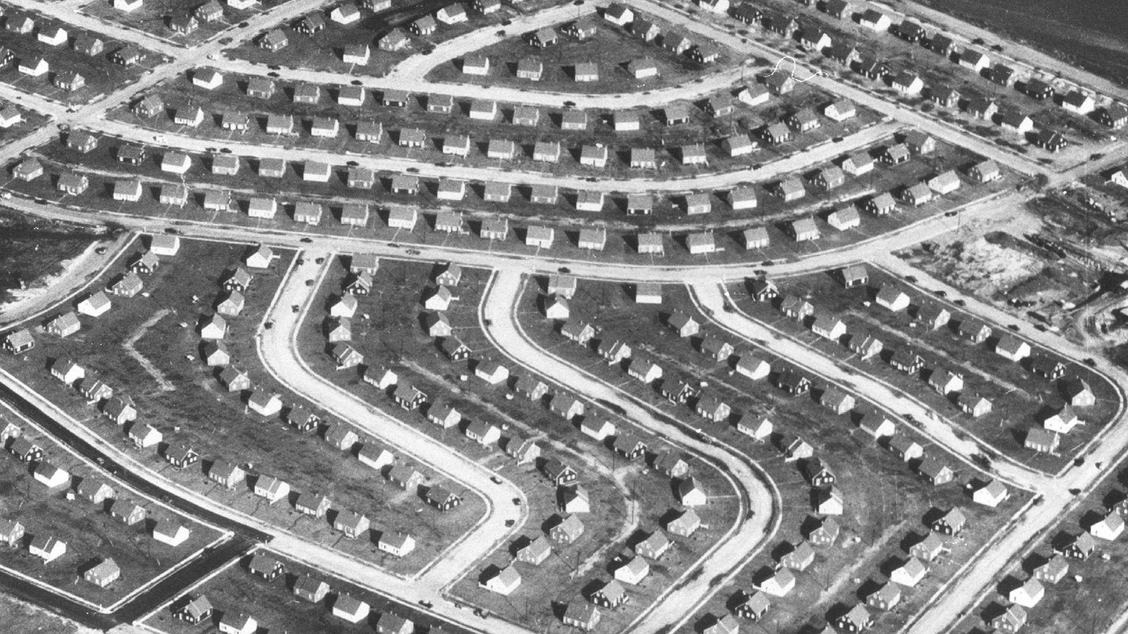

Slide 7
Little boxes on the hillside, Little boxes made of ticky tacky,¹ Little boxes on the hillside, Little boxes all the same. There's a green one and a pink one And a blue one and a yellow one, And they're all made out of ticky tacky And they all look just the same.
And the people in the houses All went to the university, Where they were put in boxes And they came out all the same, And there's doctors and lawyers, And business executives, And they're all made out of ticky tacky And they all look just the same.
And they all play on the golf course And drink their martinis dry, And they all have pretty children And the children go to school, And the children go to summer camp And then to the university, Where they are put in boxes And they come out all the same.
And the boys go into business And marry and raise a family In boxes made of ticky tacky And they all look just the same. There's a green one and a pink one And a blue one and a yellow one, And they're all made out of ticky tacky And they all look just the same.

Slide 8
A Date with Your Family
https://www.youtube.com/watch?v=Gd7RqwgDUDg

Slide 9
Role of Women
Popular culture glorified marriage and parenthood more then any other era.
Women were told to be “helpmates” to their husbands and full time mothers to their children
“A woman isn’t a woman until she is married and had children.” (The Tender Trap)
Working women were called “a menace” (Esquire)
The ideal wife was married at 16, raised 4 children, cooked and sewed, headed the PTA and exercised to keep her size 12 figure (Life)

Slide 10
Youth Culture
Rock and Roll:
Large group of youth that just wanted to have a good time, listen to exciting music, etc. (Elvis Presley gets super popular)
Beatniks
Group of youth that were unhappy with society and wrote poetry to express their frustrations
“Non-conformist”

Slide 11
Consumerism

Slide 12
Television
TV ownership rose as the cost of owning them dropped.
In 1952, TV Guide outsold every other magazine.
The TV Dinner was introduced in 1954 and altered America’s eating habits.
TV affected everything about American culture

Slide 13
Effects of Television
Shows like “Leave it to Beaver”, and “I love Lucy” portrayed a perfect family life and not the reality of everyday homes.
Moms were always pretty and doing domestic things
Children were adventurous but obedient
Dads never worked late, never lost their temper and knew all the right answers.
How does that effect American culture?

Slide 14
Advertising
Companies shifted advertising campaigns to the television
They encouraged Americans to “keep up with the Joneses” and buy on credit
Rise of franchises like McDonalds appealed to the nations sense of conformity.
Examples: https://www.youtube.com/watch?v=Et0GocBFrKo&feature=related

Slide 15
TV and Culture
TV made fun of things in American culture
I Love Lucy:
Advertising- https://www.youtube.com/watch?v=4AZK2-Tfc84
Gender Roles- http://www.schooltube.com/video/04b72f25fdc37c64128c/Job%20Switching%20Pt%202/3

Slide 16
Automobile
Automobiles become more common as they become cheaper and people have more money
People can live in the suburbs and commute to work

